Slide 1
Getting Started with Git & Github
James Molyneux
Assistant Professor
Oregon State University

Slide 2
Who am I?
I am James.
Lover of:
Tea, Nimbus the Cat, Noise (musical instruments)
Researcher of:
Statistics Education, Spatial/temporal Models
Maker of:
Software, Quesadillas, Noise

Slide 3
Workflows
Notes:
This is a workshop about Git and Github … but really it’s a workshop about workflows.
How do we setup workflows that help keep ourselves organized, give us freedom to try things without losing our progress, and collaborate as members of teams?

Slide 4
Goals
Get people familiar with some of the language of Git and Github
Motivate people to build better workflows for themselves
Help everyone see that Git and Github are useful tools for collaboration and building a code portfolio

Slide 5
Outline
What is Git/Github and why should I care?
What do I need to get started with Git and Github?
How can I use Git and Github to be more productive?
Where can I find out more about using Git and Github?

Slide 6
Chapter 1: Git & Github
What is Git/Github and why should I care?

Slide 7
awesome_function <- function(x) {
b0 <- x[1]
b1 <- x[2]
y <- b0 + b1 * seq(0, 10, by = 0.1)
result <- plot(seq(0, 10, by = 0.1), y)
return(result)
}
💡
💻
🙂
🏅
Notes:
You get an idea and so you head to your computer and write up a function. At the end, you have some working code and you’re happy =)

Slide 8
🕔
💡
broken_function <- function(x, y, df) {
b0 <- x[[1]]
b1 <- x[2]
y <- b0 + b1 * df$x
result <- plot(x, y)
y1 <- df$y – y
y2 <- y1^2
new_func <- function(x) {
b0 + b1 * df$x
(df$y – (b0 + b1 * df$x))^2
}
optim(par = c(0, 0, fn = new_funct)$val
return(plot)
}
awesome_function <- function(x) {
b0 <- x[1]
b1 <- x[2]
y <- b0 + b1 * seq(0, 10, by = 0.1)
result <- plot(seq(0, 10, by = 0.1), y)
return(result)
}
😭
💻
💥
Notes:
After some time though, you get a new idea and head back to your computer to update your previous code. In the process of making the updates, you end up breaking the code and now feel stranded because you can’t “go back” to the previous working version.

Slide 9
Git
Version control software
Let’s you update files…
… and more easily fall back to previous versions
How does it work?
You tell Git which files to track.
You edit those files and commit the changes.
Git keeps track of what the files “looked” like when you made the commits.

Slide 10
💡
💡
💡
💡
🤵‍♂️
🤵‍♀️
🧑‍🔬
🧑‍💻
🤵‍♀️
Notes:
Scenario 1: You’re someone with lots of good ideas (Or maybe a student who has some neat projects you’ve worked on) and you want some way to show off/share those projects so employers might offer you a job. Or maybe you have some code or files that you think other people might be able to use, if only you could easily share them.

Slide 11
💡
💡
💡
💡
💡
💡
💡
💡
🧑‍💻
👩‍💻
🔁
🧑‍💻
👩‍💻
Notes:
Scenario 2: You and a friend (Or maybe you work on a team) have lots of good ideas, and so you want to work on projects together, but you need some way to share files.
You could email files back and forth … but this is a hassle and you’re never quite sure where to put files or which file is the latest version
You could use Cloud drives, but then you’re never sure if you’re working on the same files at the same time and causing conflicts

Slide 12
GitHub
A website that lets you share code and other project files with others.
Can keep repositories private, to share them with individuals.
Or make them public, to let anyone see, use, or build off of them.
Contains loads of features designed to help people collaborate.
Keep track of issues, bugs, ideas.
Let you discuss changes before merging them.
And more!

Slide 13
Chapter 2: Getting Setup
What do I need to get started with Git and Github?

Slide 14
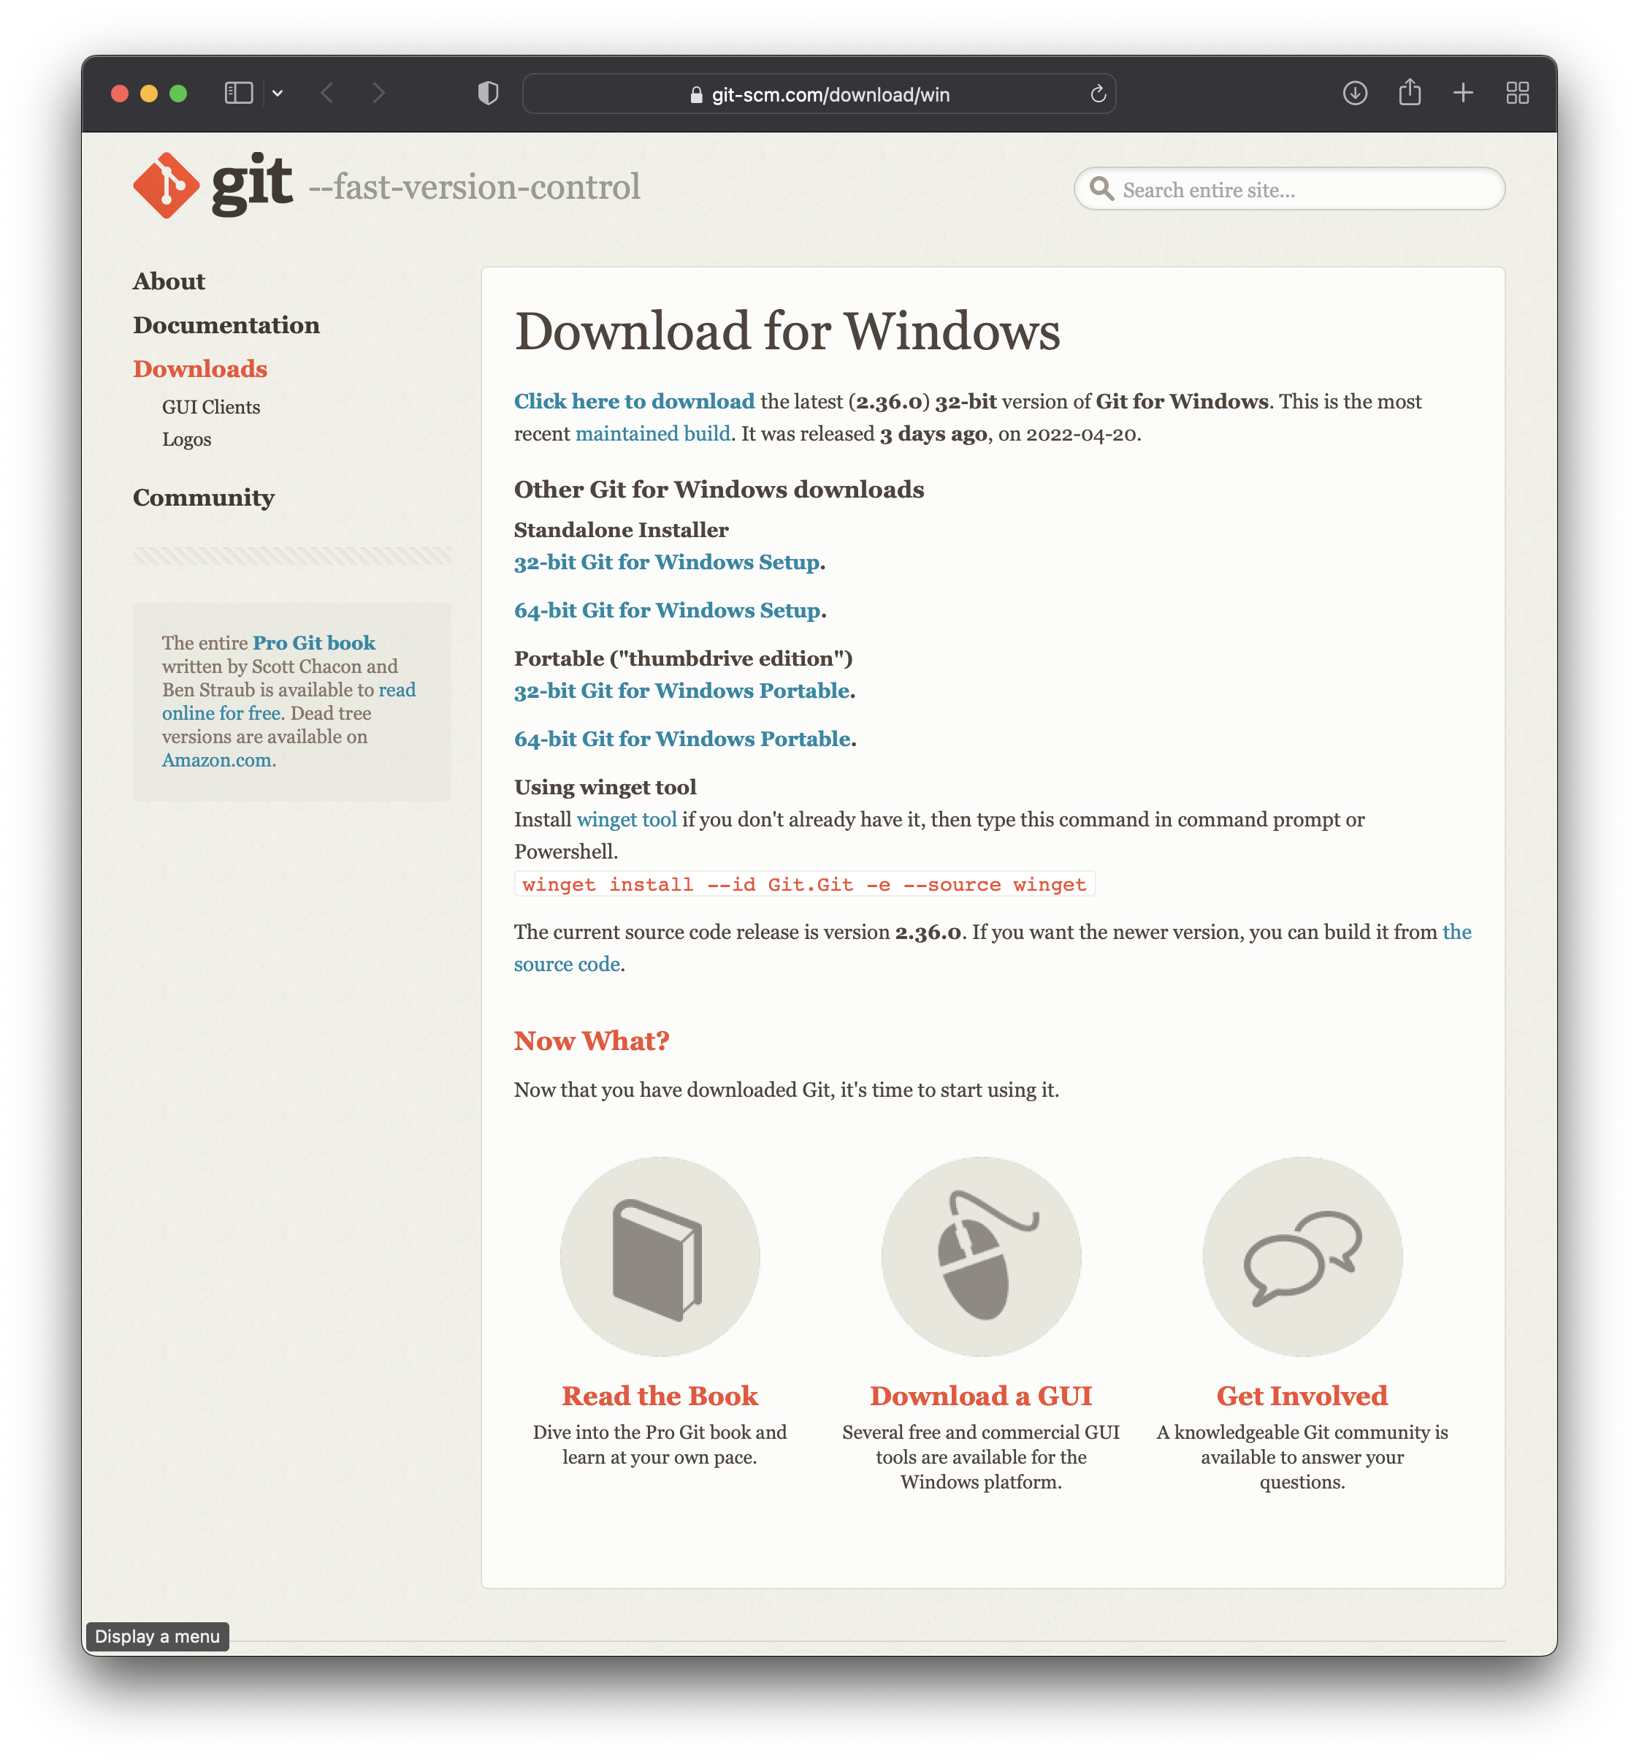
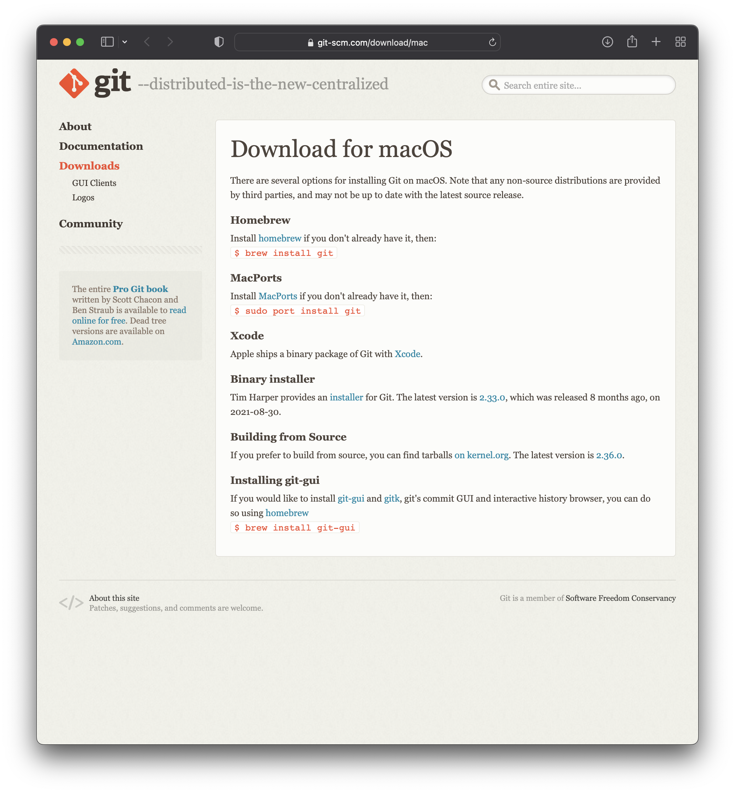
Step (1) : Install Git
Windows: https://git-scm.com/download/win
Mac: https://git-scm.com/download/mac

Slide 15
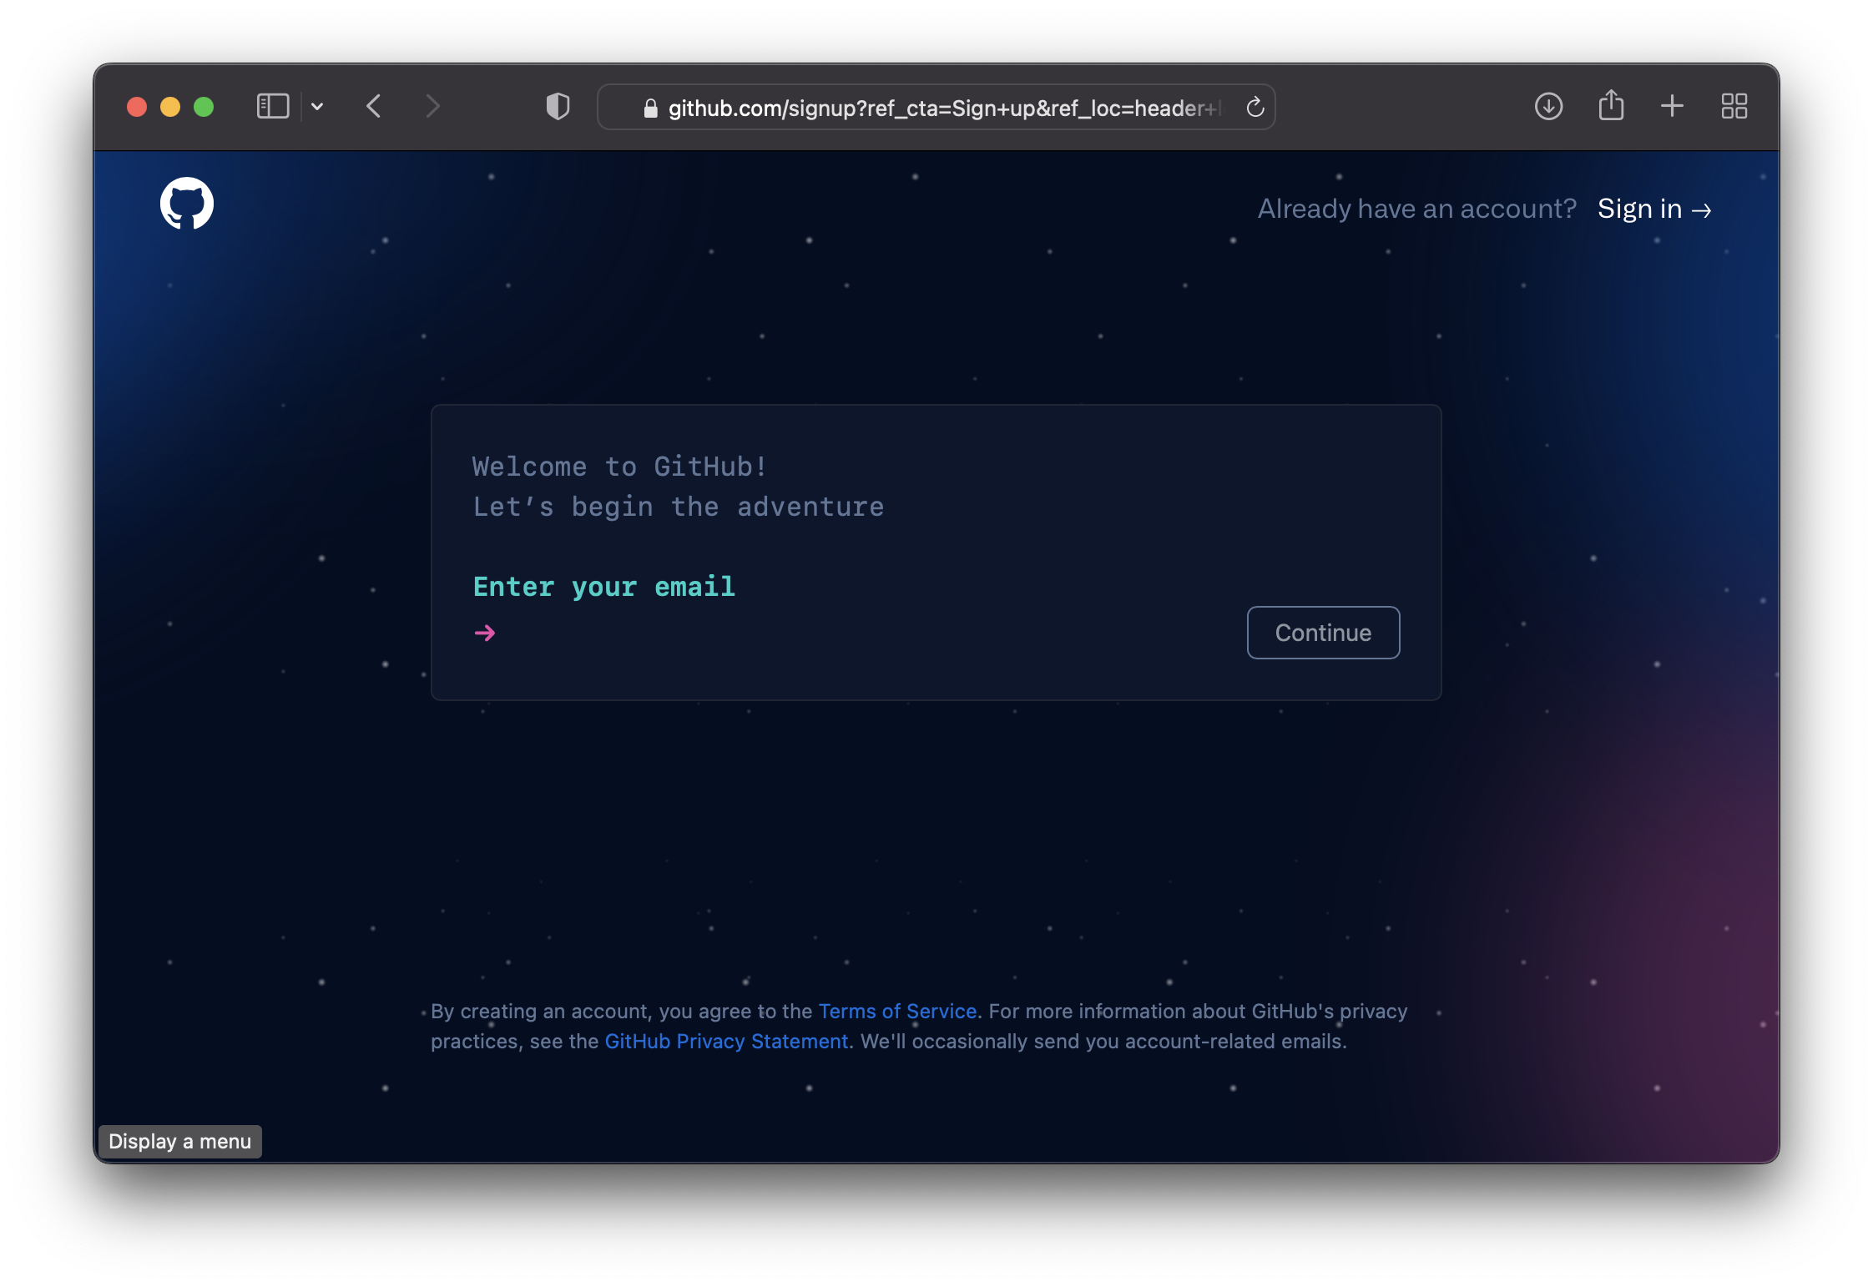
Step (2) : Sign-up for Github
Github (“free”): https://github.com
Student Dev Pack: https://education.github.com/pack

Slide 16
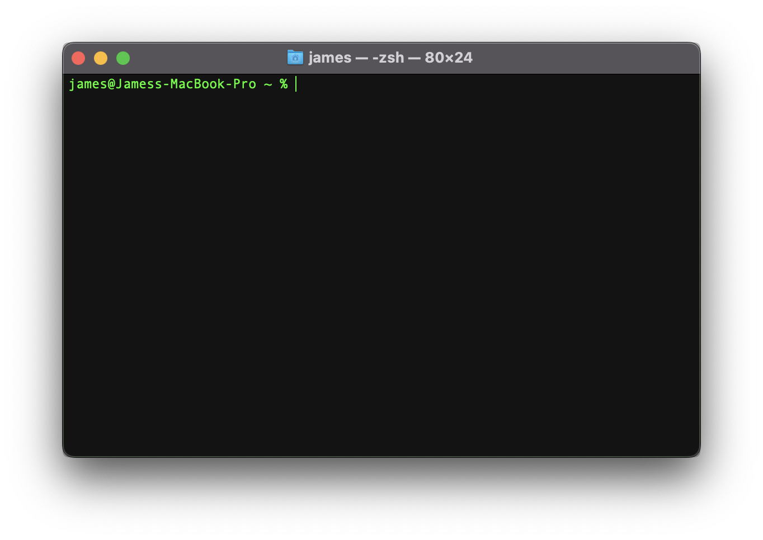
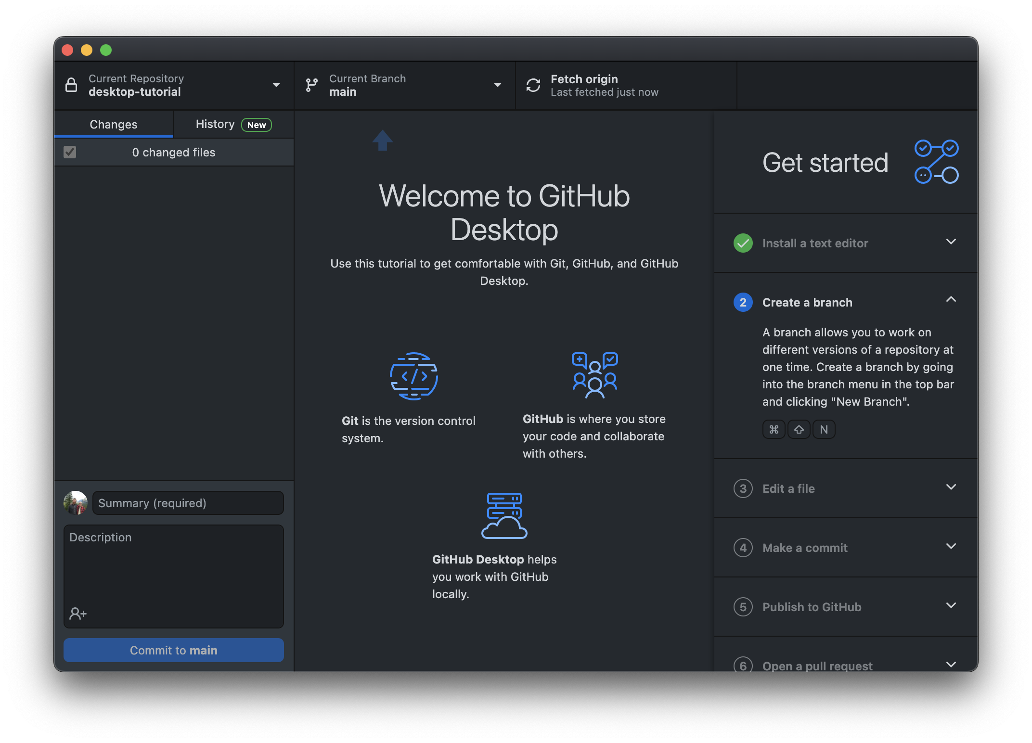
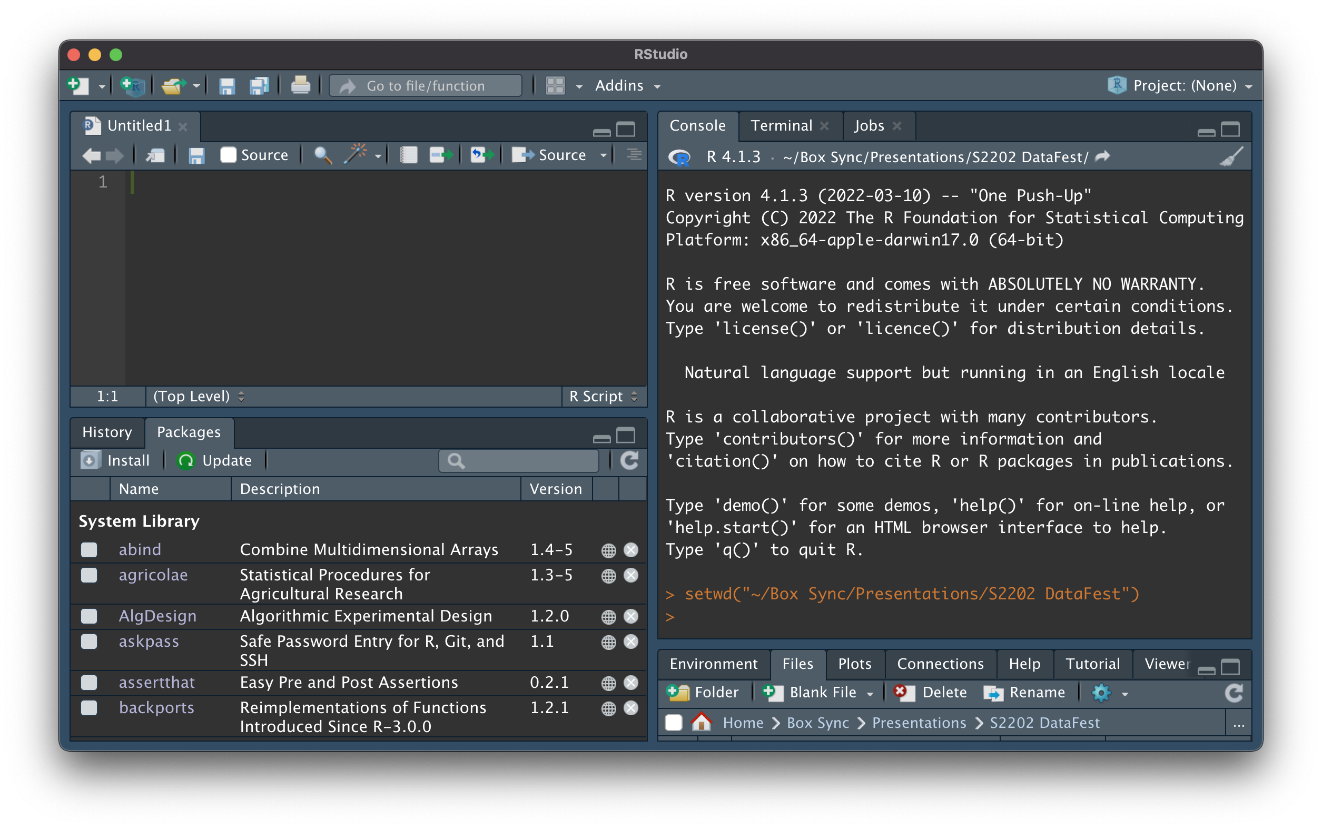
Step (3) : Choose an Interface
Github Desktop
https://desktop.github.com
Rstudio
https://www.rstudio.com
Terminal/Bash/Shell
Notes:
Git is designed to be used with a terminal interface, but the Desktop Application is also helpful to get you up and running (It even comes with a tutorial!). Rstudio does many of the “main” Git and Github things pretty well.
For now, I’ll assume folks are using Rstudio.

Slide 17
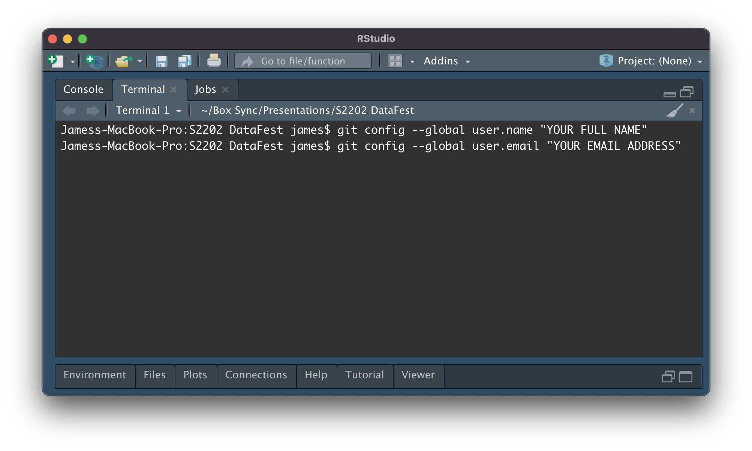
Step (4) : Tell Git Who You Are
Open a “Terminal” window in Rstudio and run:
git config --global user.name "YOUR FULL NAME"
git config --global user.email "YOUR EMAIL ADDRESS"
Notes:
You can keep your life “easy” by using the same email address you used in the Github account sign-up step.

Slide 18
Chapter 3: Building Better Workflows
How can I use Git and Github to be more productive?

Slide 19
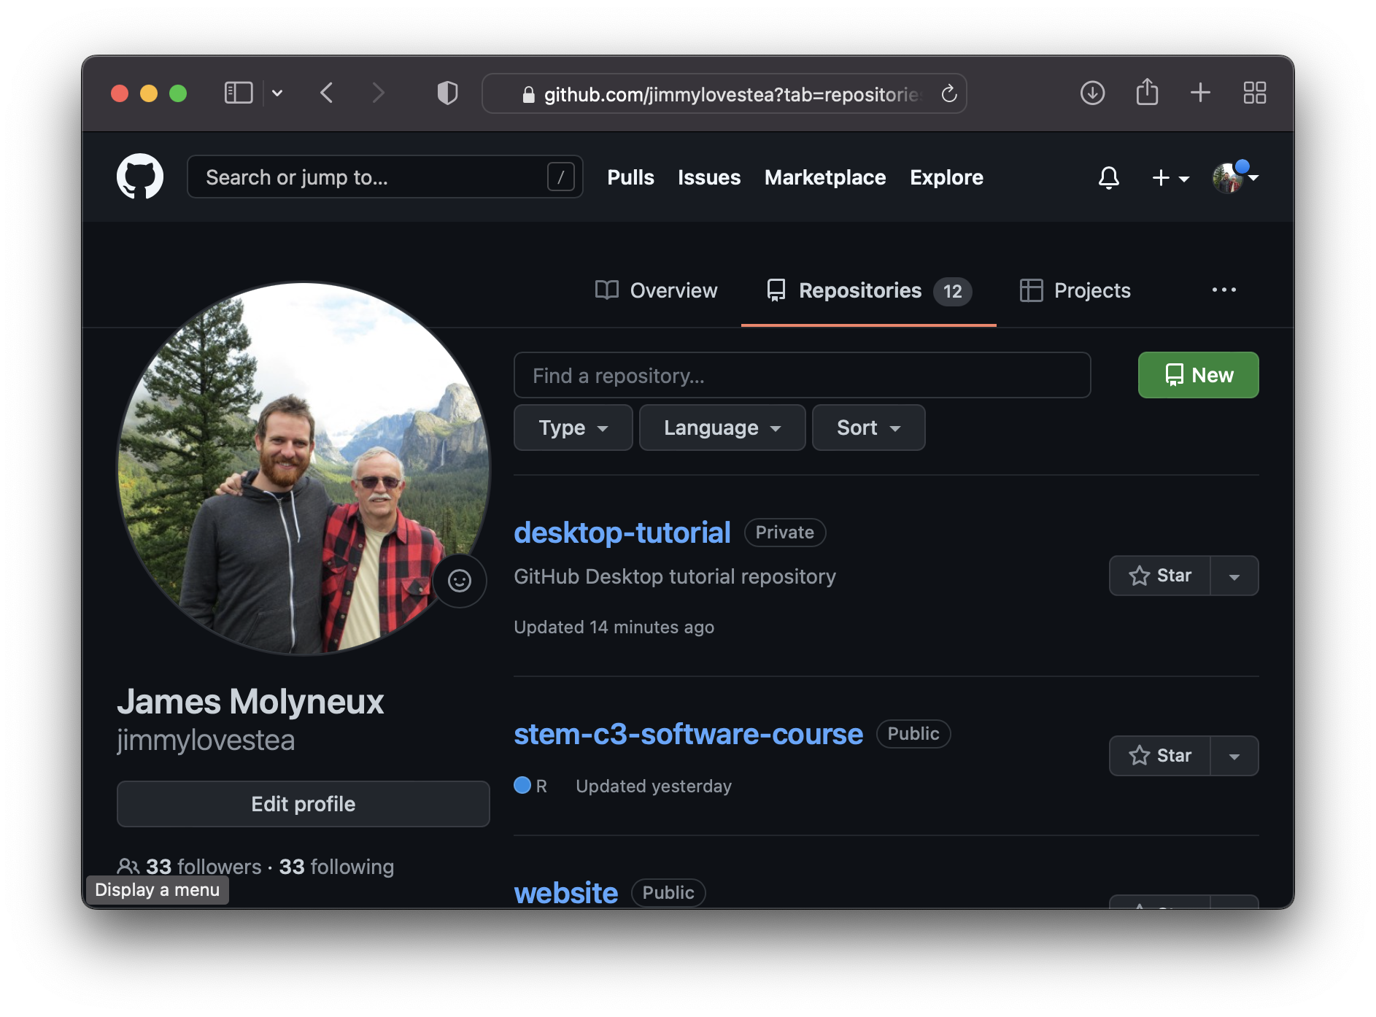
Step (1) : Create a New Repository
Go to your Github Account
View your repositories
Click “New”

Slide 20
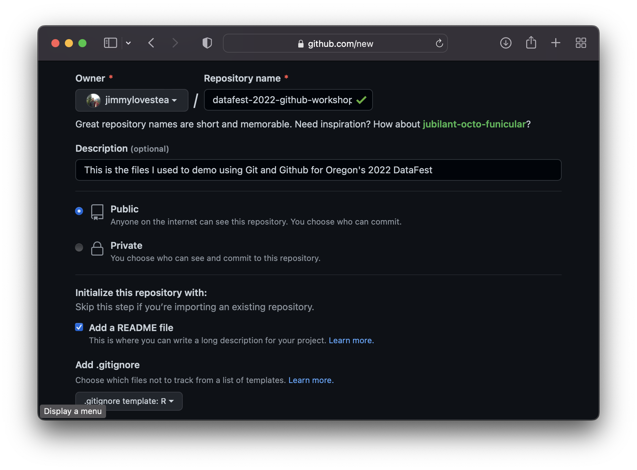
Step (2) : Setup Your Repo
Give your repo a descriptive name (No spaces in the repo names)
Add a description so future you can remember what this project was about.
Decide whether to make it public (Available for everyone) or private (Available to you and people you invite)
Add a README file
[Optional] Add a .gitignore file and/or a license file (What will you allow users to do with your code?)

Slide 21
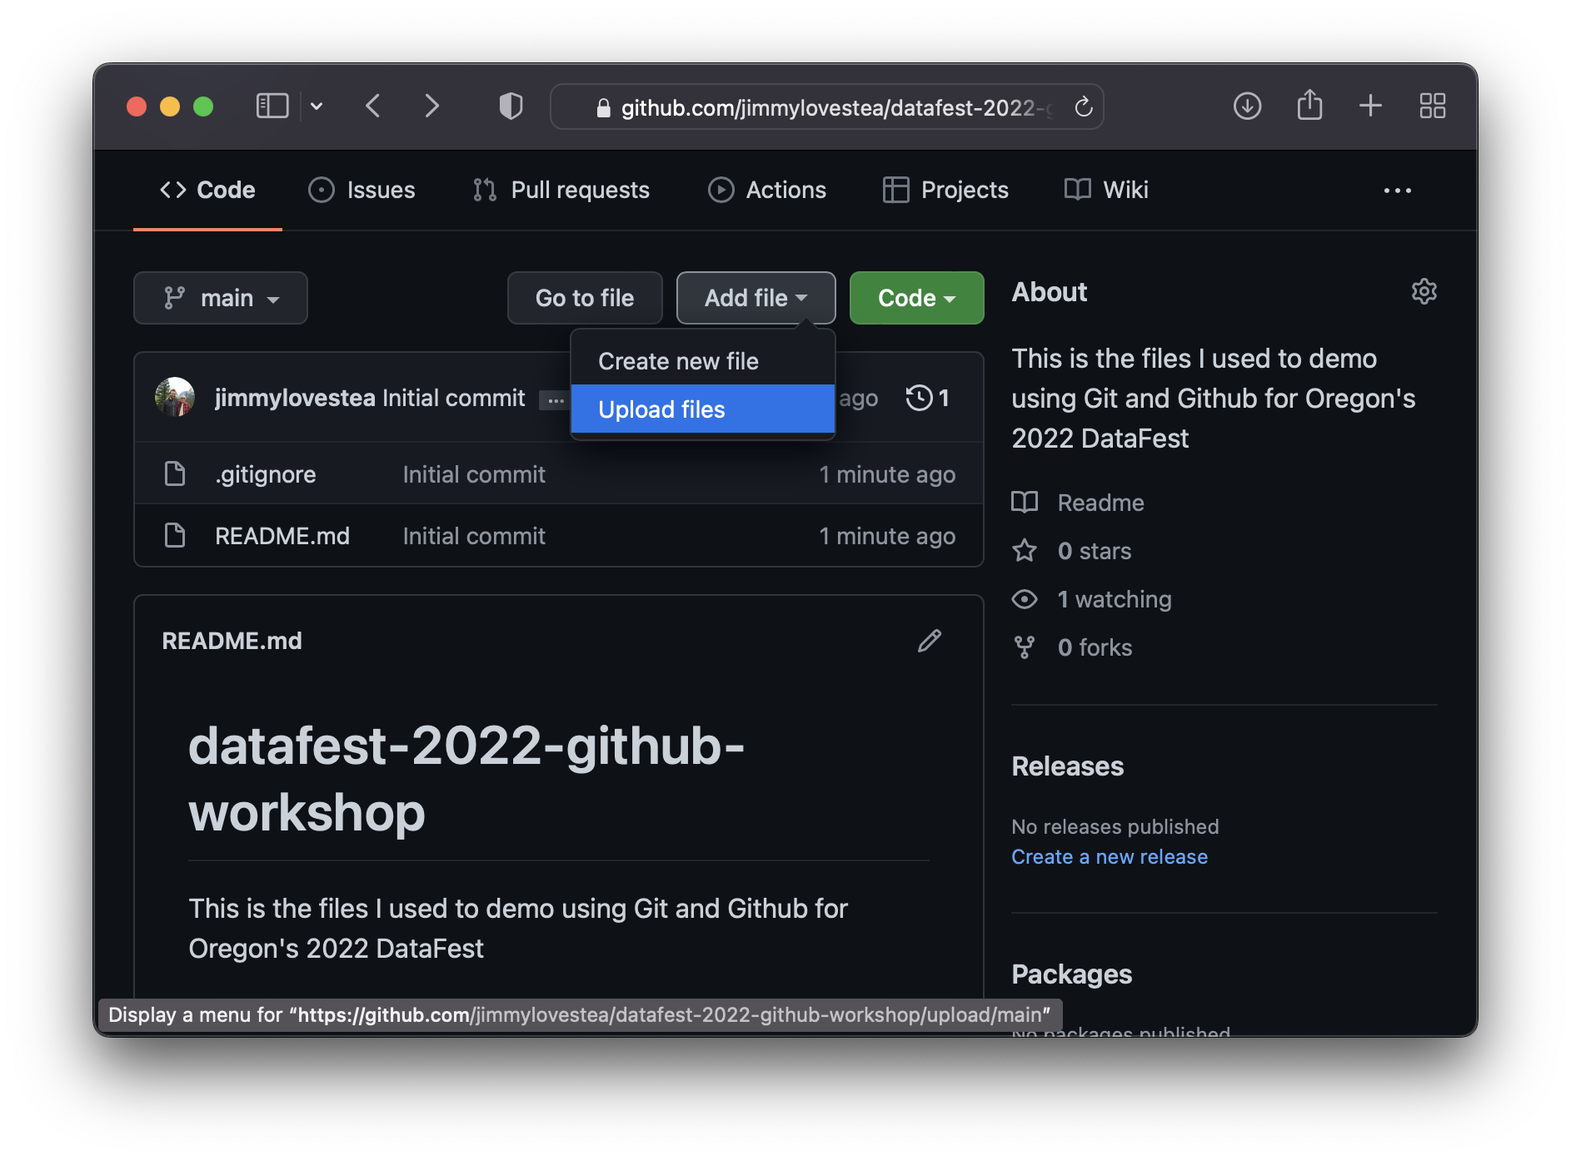
Step (3) : Upload Files via the Website
Upload files using the web interface (This is especially helpful for large files due to data transfer limits)

Slide 22
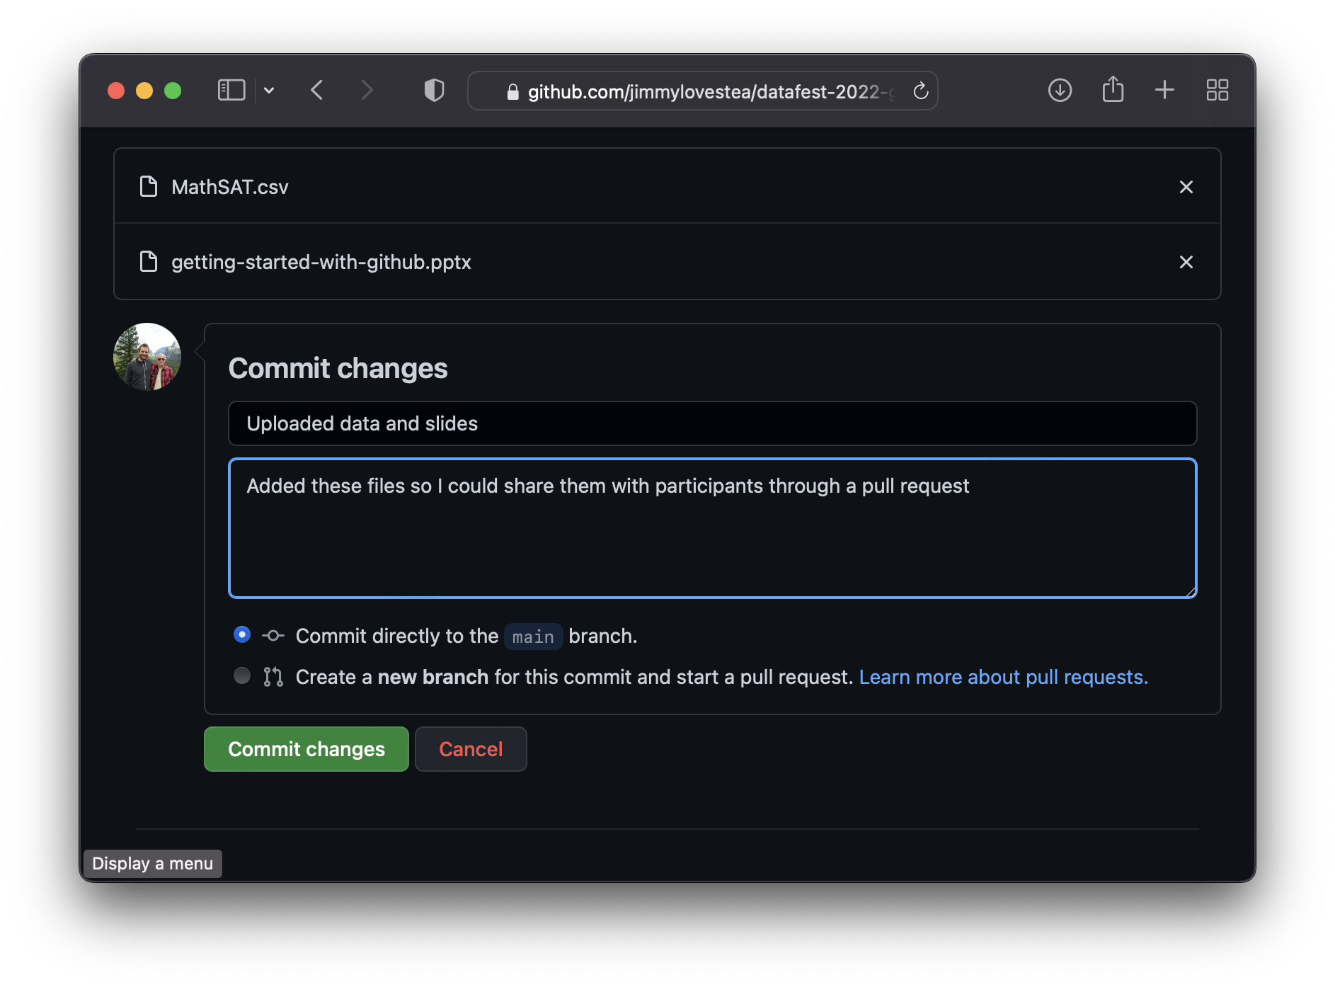
Step (3) : Upload Files via the Website
Upload files using the web interface (This is especially helpful for large files due to data transfer limits)
Then commit the changes. This commit serves as a “bookmark” in time that we’ll be able to return to in the future if need be.

Slide 23
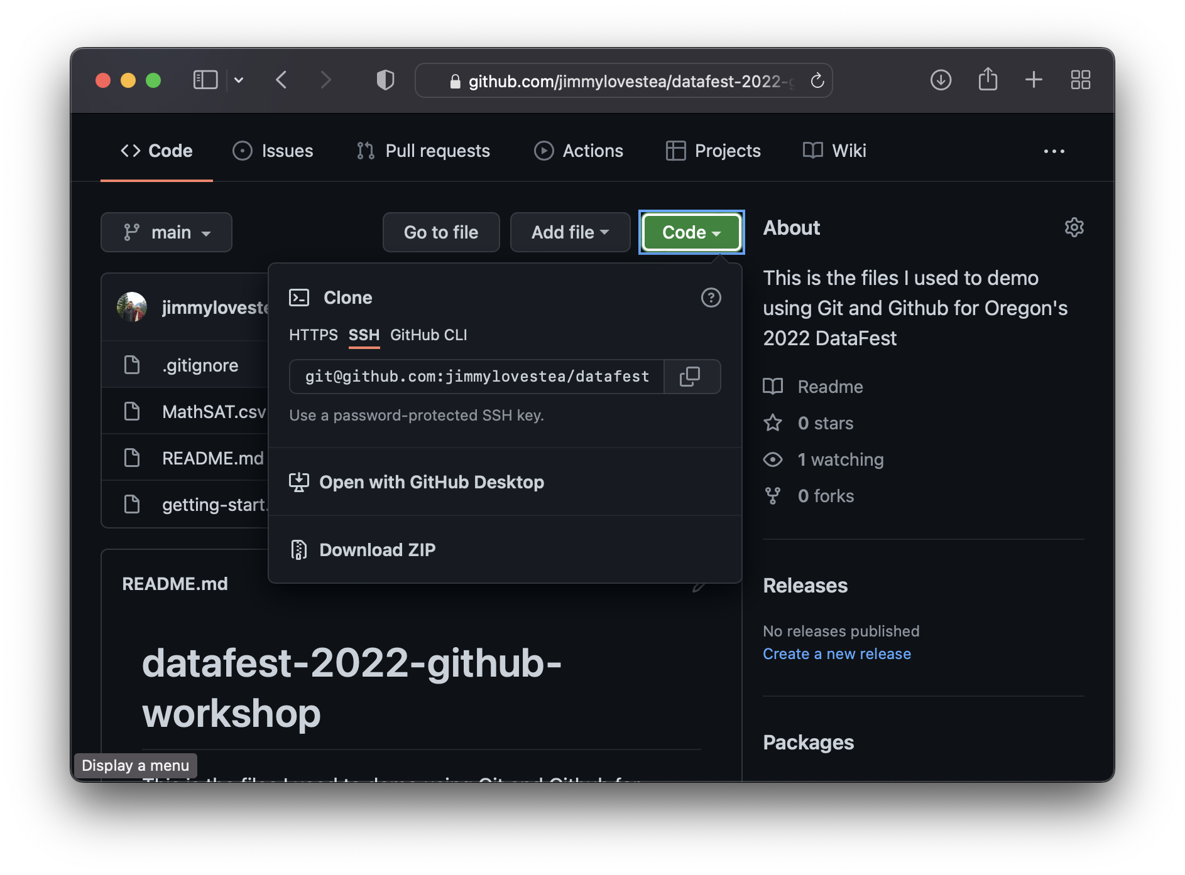
Step (4) : Sync Your Repo with RStudio
Back in your repo, click the green “Code” button. Then copy the URL using HTTPS (Or SSH if you have that setup)

Slide 24
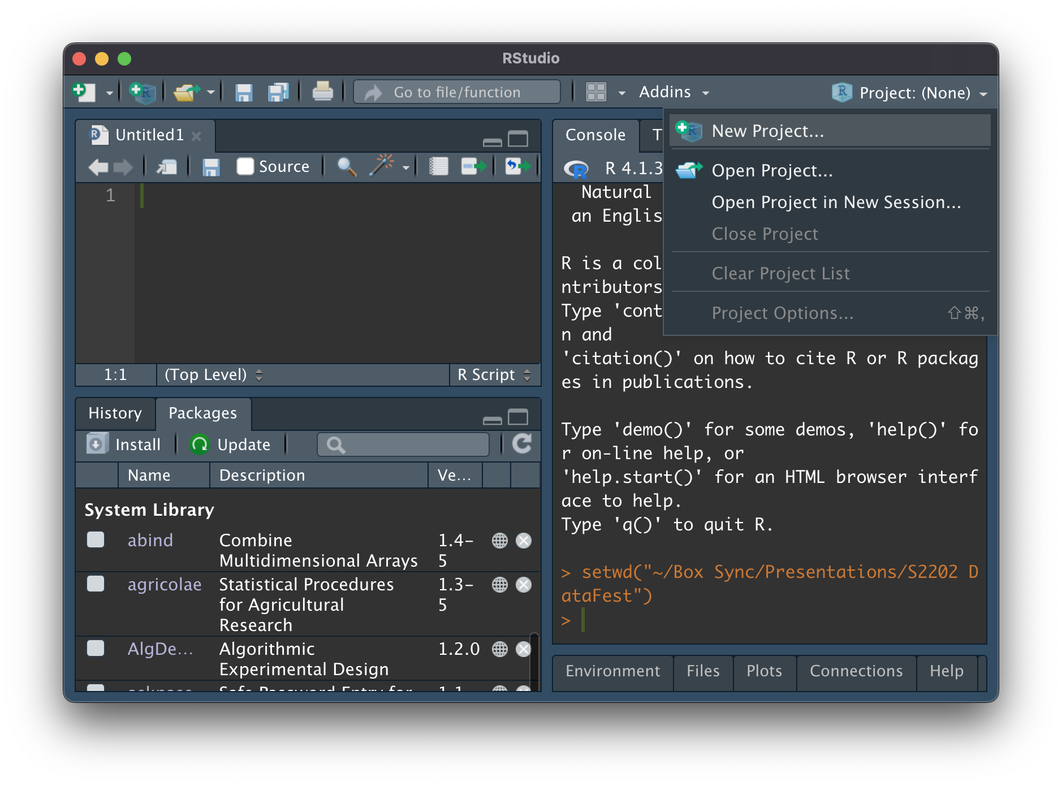
Step (4) : Sync Your Repo with RStudio
Back in your repo, click the green “Code” button. Then copy the URL using HTTPS (Or SSH if you have that setup)
In Rstudio, create a New Project...

Slide 25
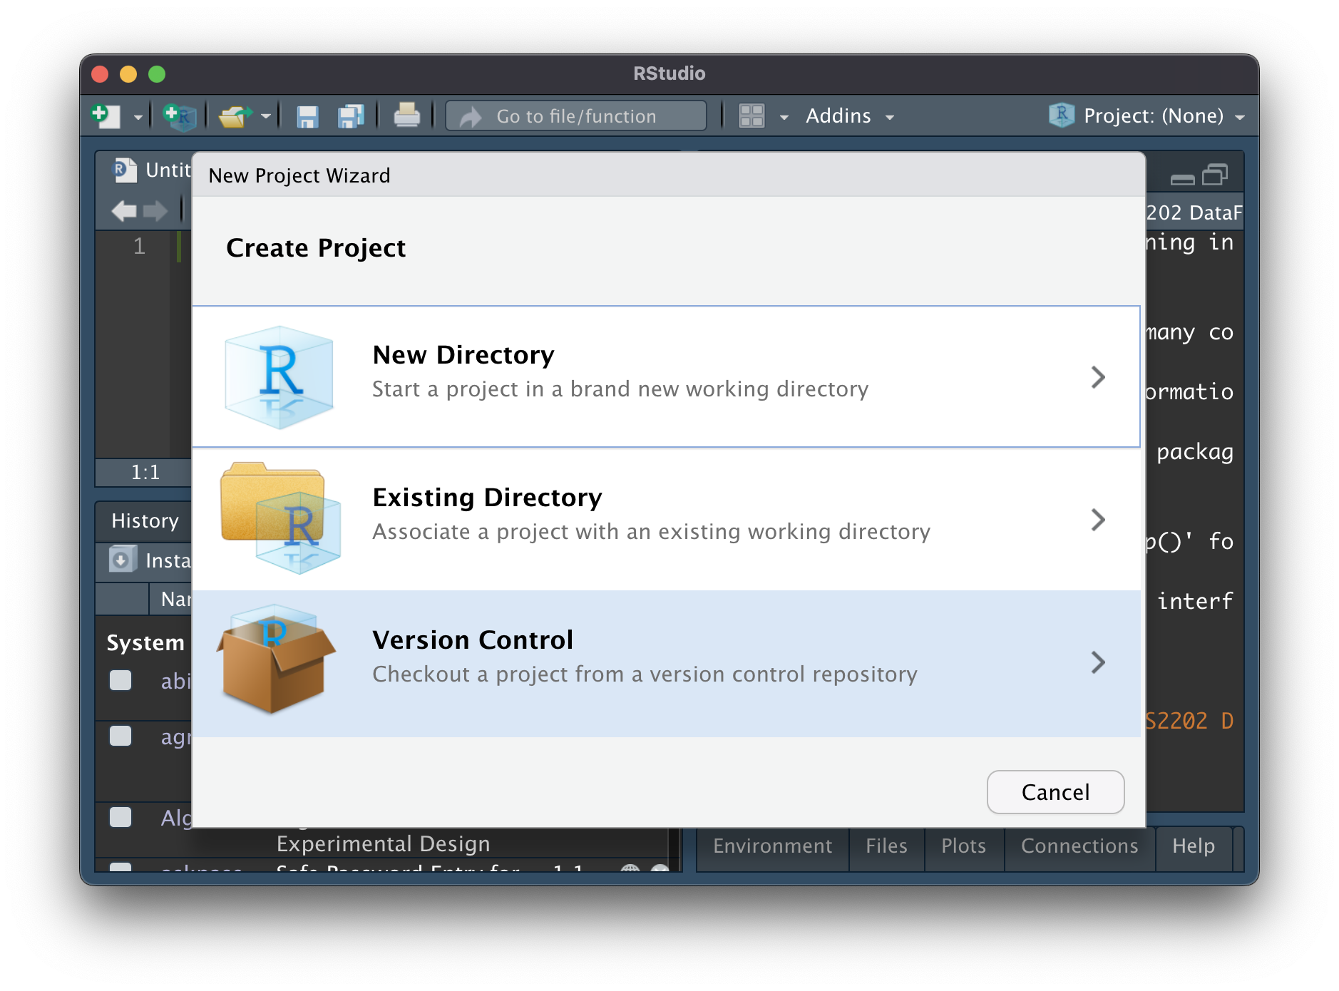
Step (4) : Sync Your Repo with RStudio
Back in your repo, click the green “Code” button. Then copy the URL using HTTPS (Or SSH if you have that setup)
In Rstudio, create a New Project…
… using Version Control…
… specifically with Git

Slide 26
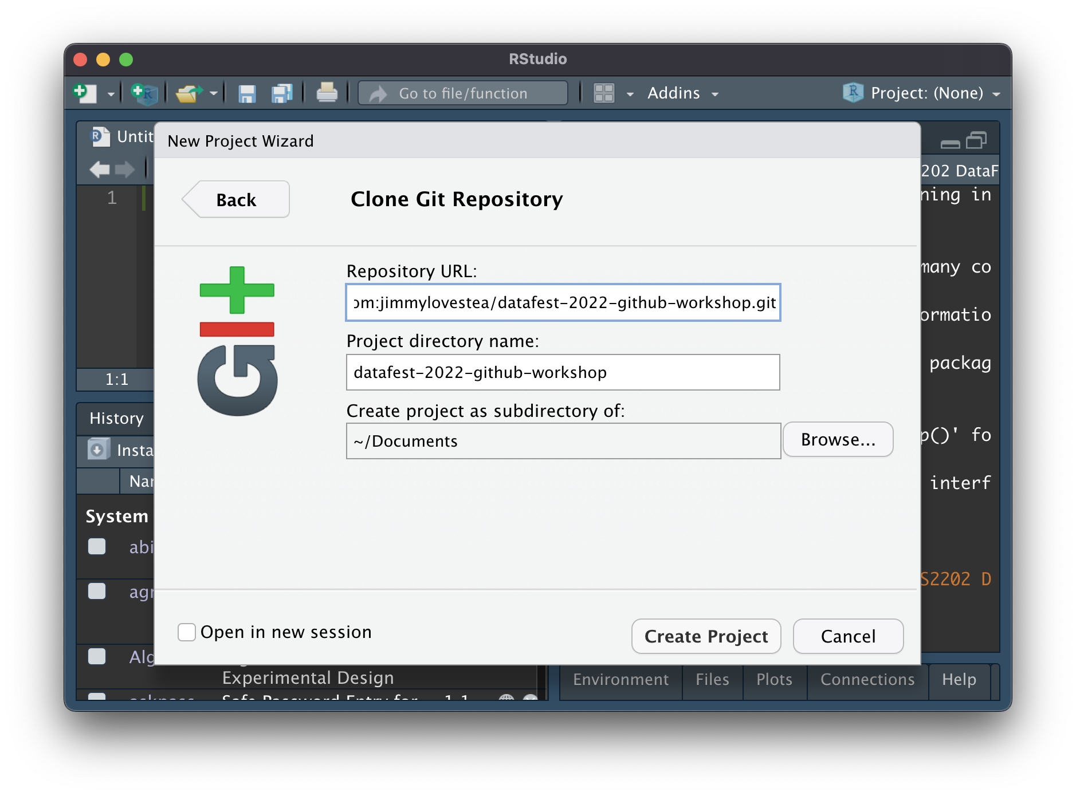
Step (4) : Sync Your Repo with RStudio
Back in your repo, click the green “Code” button. Then copy the URL using HTTPS (Or SSH if you have that setup)
In Rstudio, create a New Project…
… using Version Control…
… specifically with Git.
Paste the URL into the Repo URL Field. Then create the project!

Slide 27
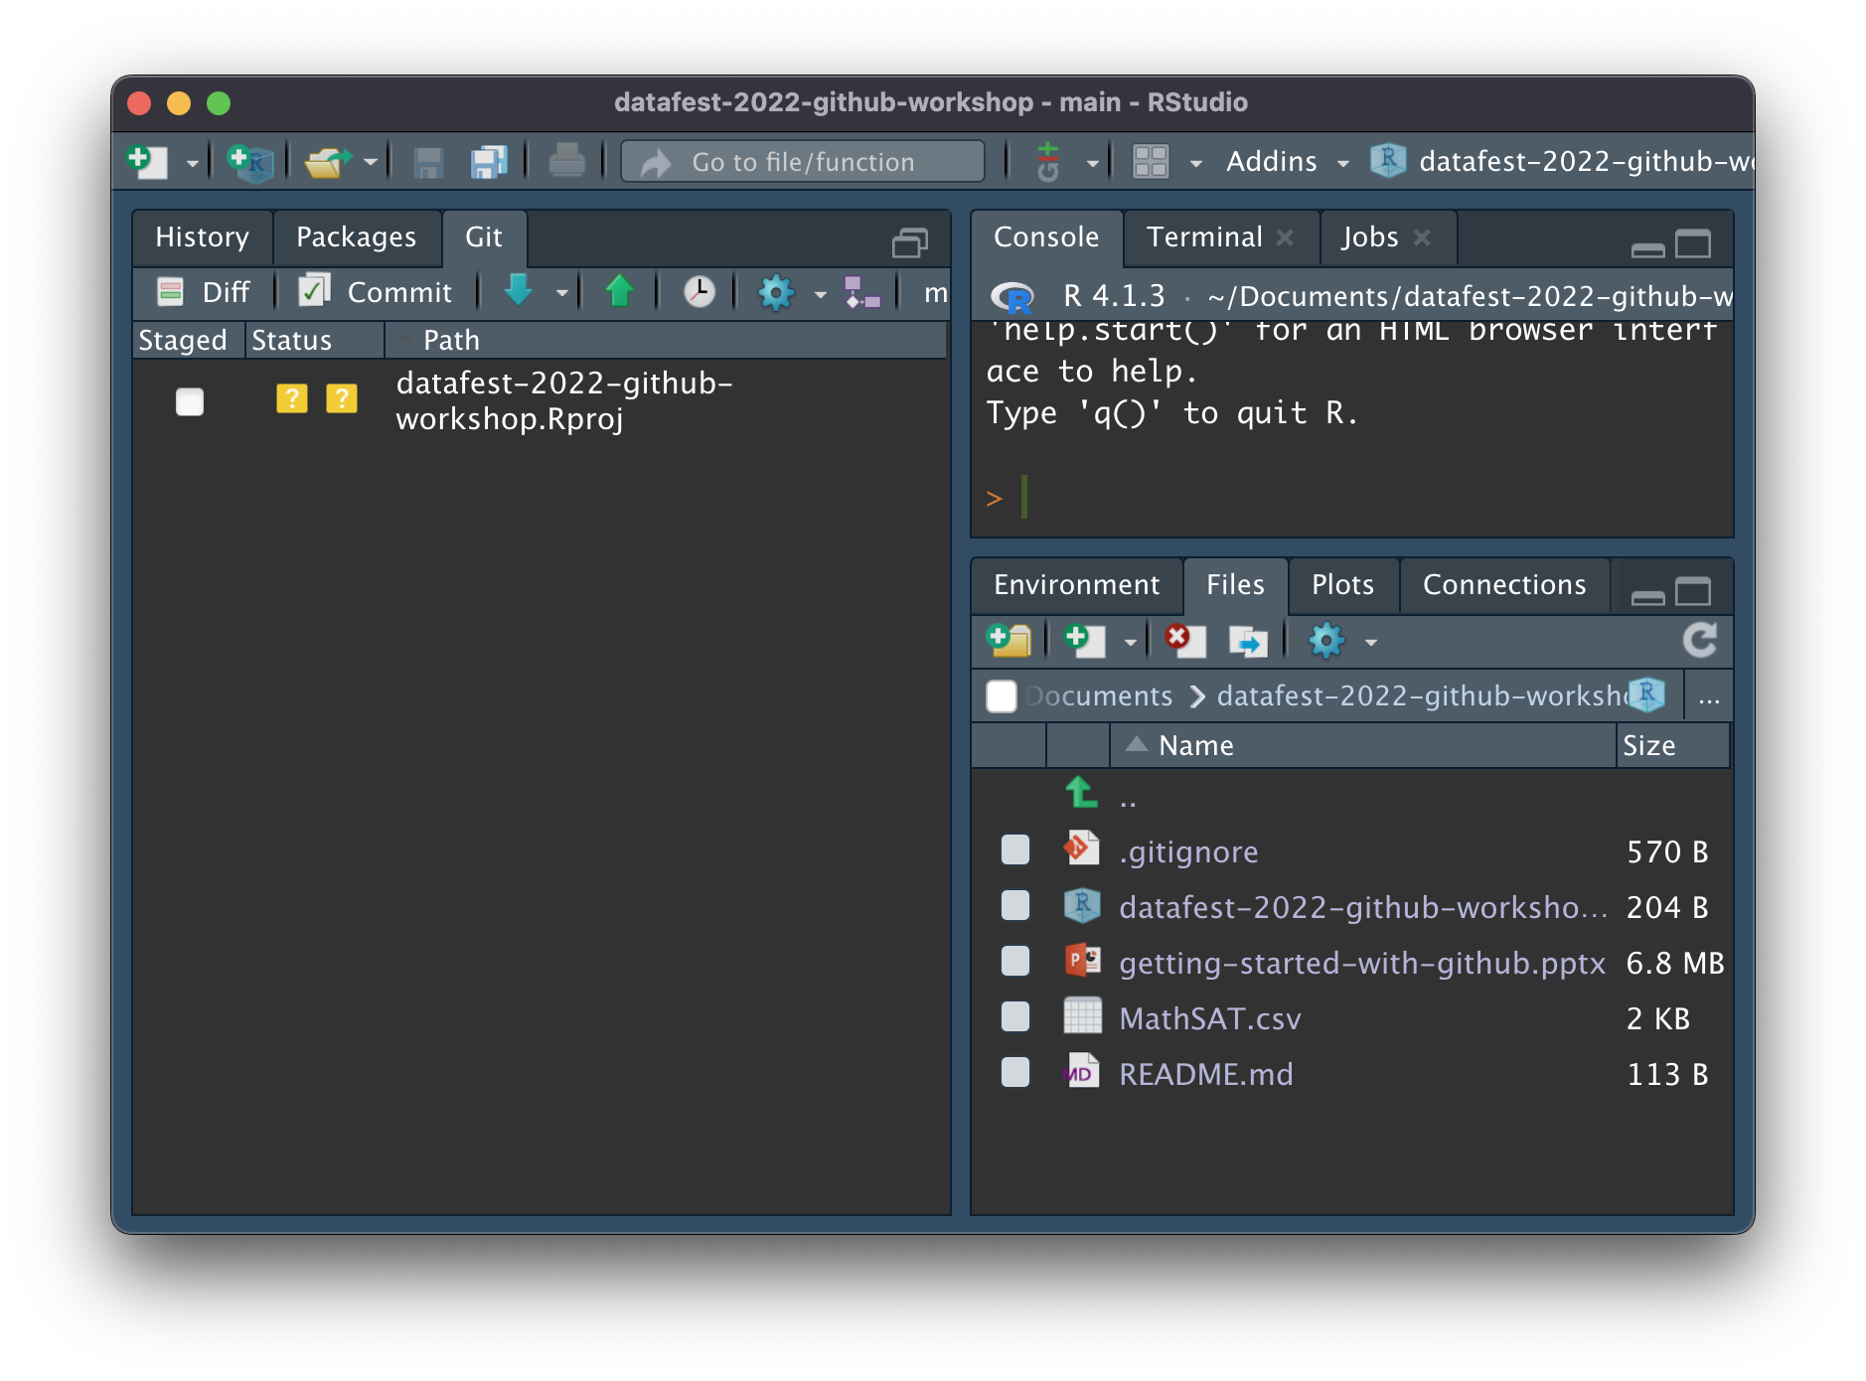
Step (5) : Voila!
You’re ready to start organizing, adding folders/files, and getting to work.

Slide 28
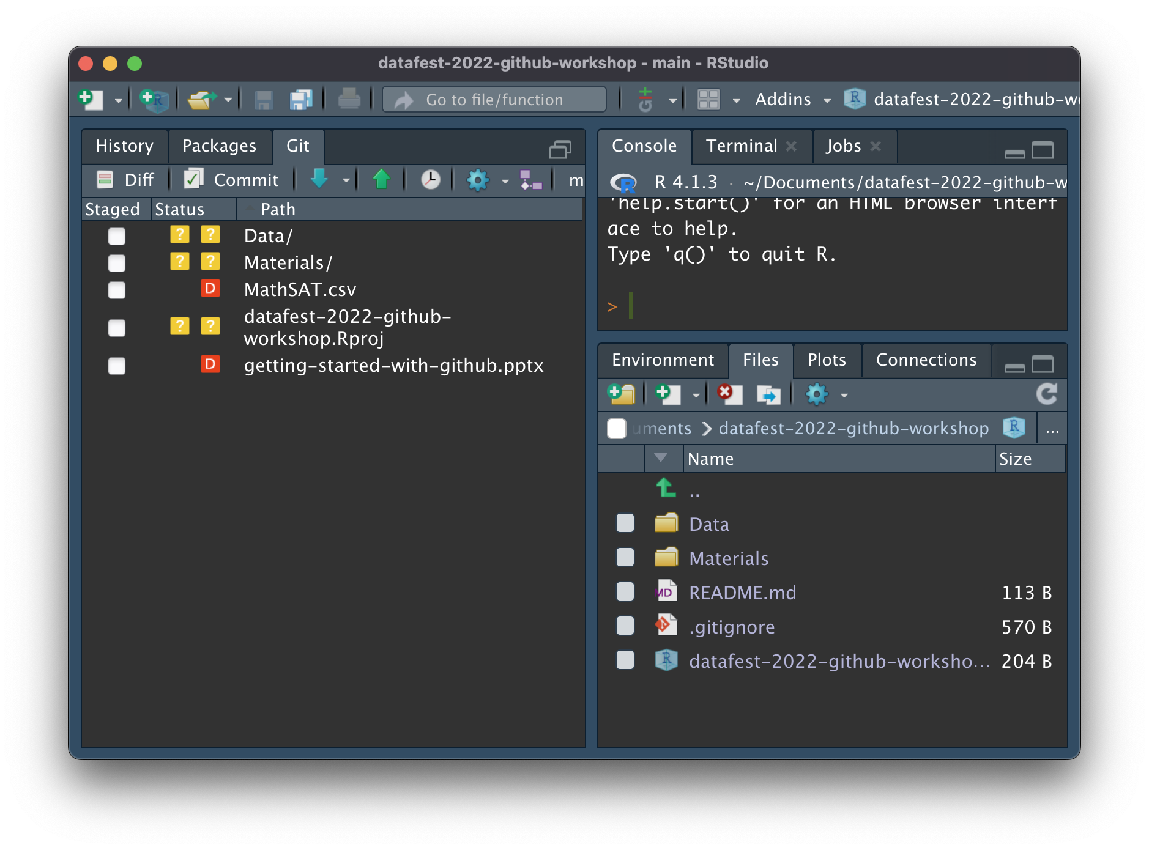
Task (1) : Clean-up, Organize, and Commit
It’s often helpful to make changes that accomplish some task and then commit those changes.
This way, we are taking “snap shots” of our files while making changes that share a similar “flavor”…
… ah, that’s better. And notice the changes that were made are described in the Git tab.
Now that my files are organized, let’s “commit” the changes I’ve made to give me a “fall back” point.

Slide 29
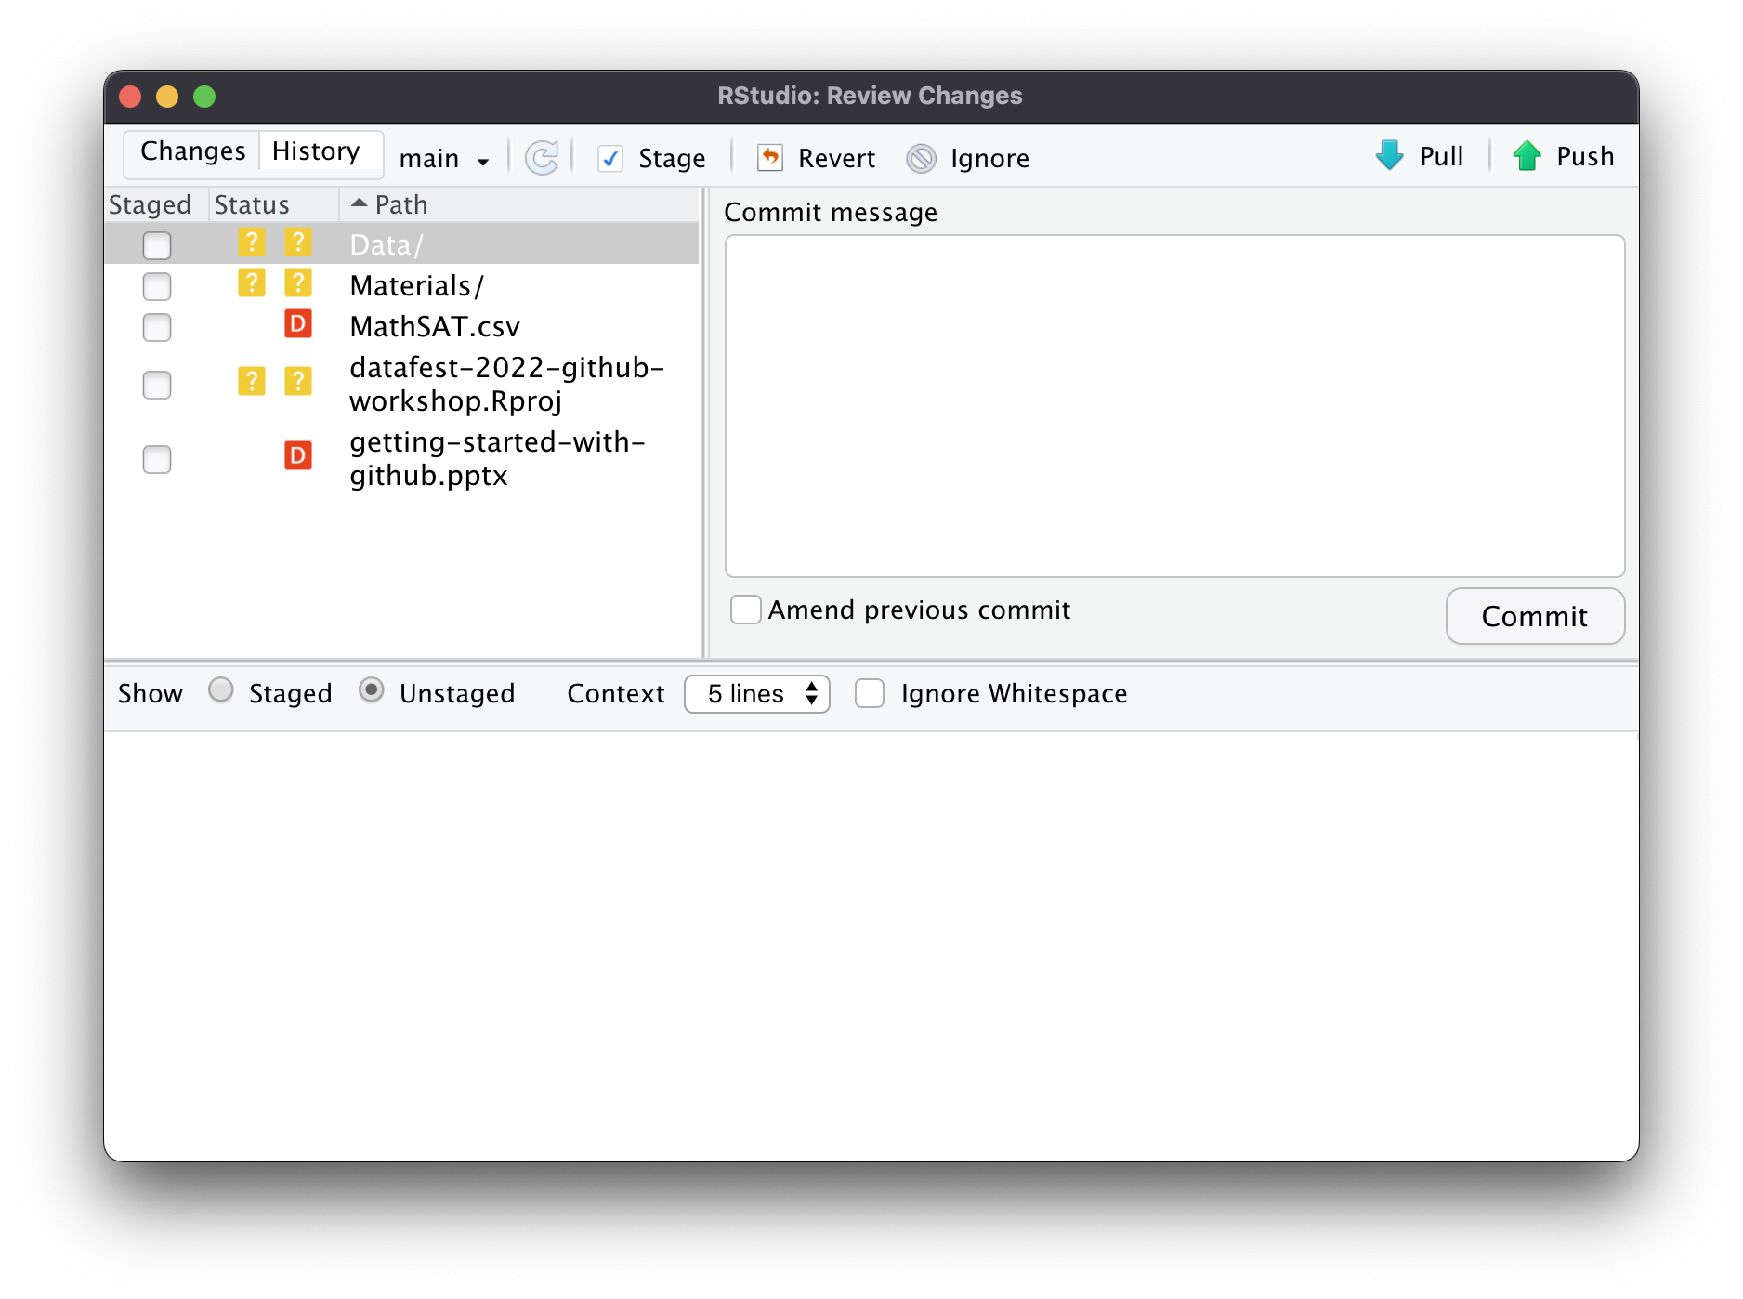
Task (1) : Clean-up, Organize, and Commit
Clicking on the “Commit” button in the Git tab brings up the following window.
Here, we can choose which files that have changed in some way to “Stage” and then ”Commit”.
Since all the files we changes so far were in regards to organizing, let’s stage all the files and write what why we made those changes in the commit message

Slide 30
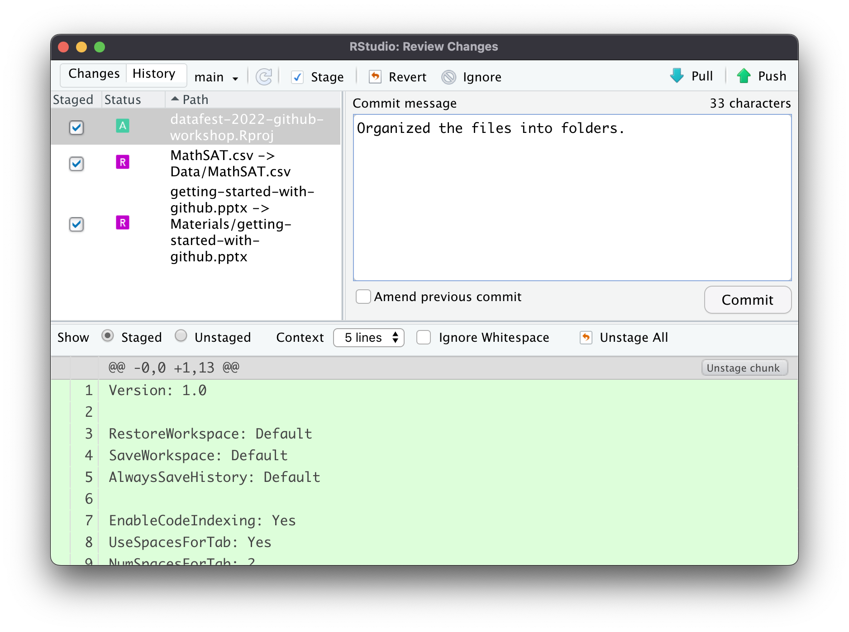
Task (1) : Clean-up, Organize, and Commit
Notice too that we can see the edits that were made to individual files by clicking on them in the upper-left, and examining them at the bottom.
And also notice that my commit message is short and descriptive. This is ideal in case I need to ”come back” to this point in my file’s history.
Once we’re ready, click “Commit”, and then Close the window.

Slide 31
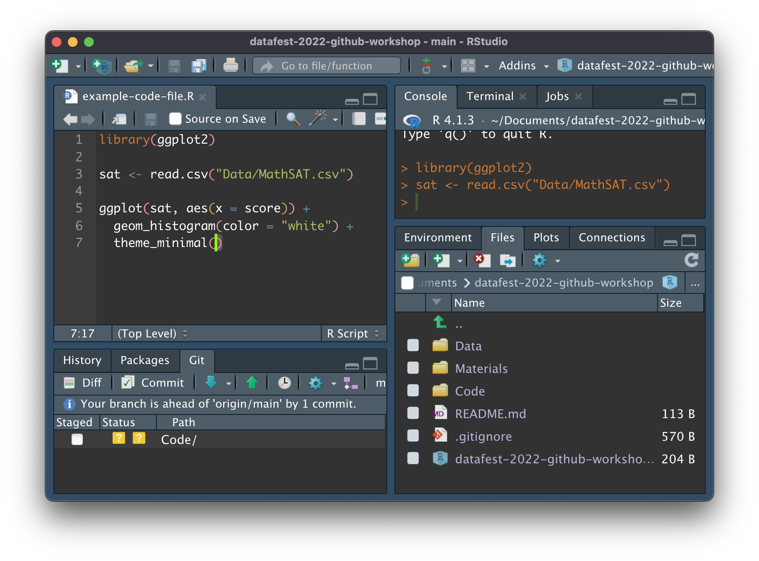
Task (2) : Add Some Code Files and Push
Create a new folder to hold your Code files.
Then create a code file which accomplishes some task.

Slide 32
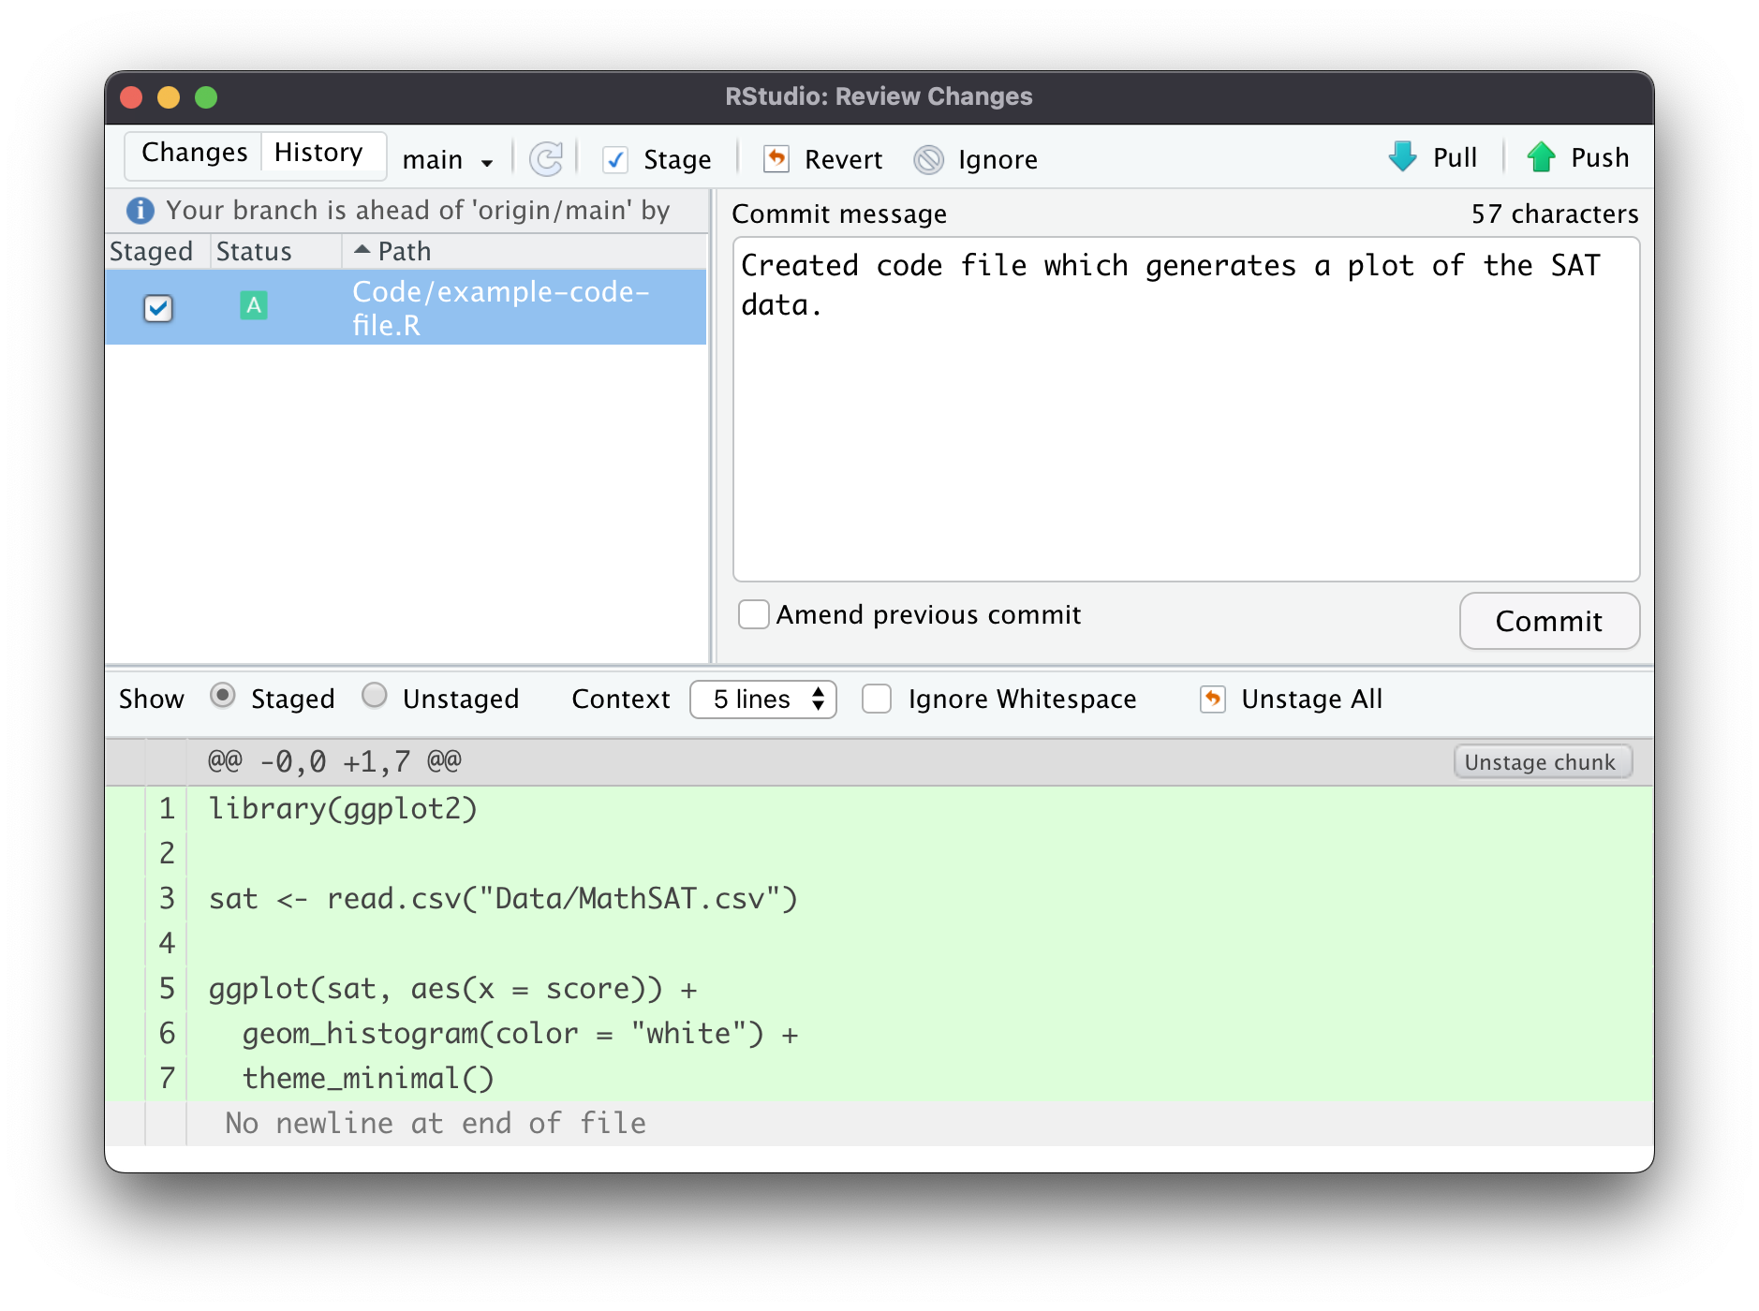
Task (2) : Add Some Code Files and Push
Create a new folder to hold your Code files.
Then create a code file which accomplishes some task.
Now that are new task is finished, let’s commit the changes again but this time, don’t close the window after hitting commit.

Slide 33
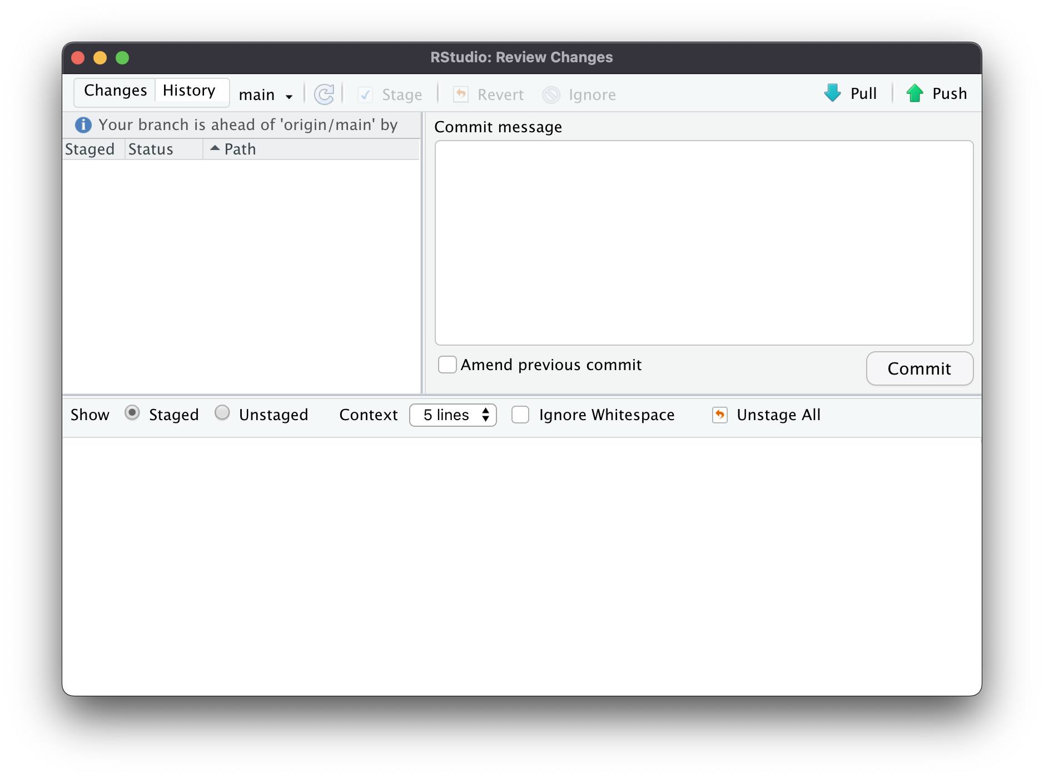
Task (2) : Add Some Code Files and Push
Create a new folder to hold your Code files.
Then create a code file which accomplishes some task.
Now that are new task is finished, let’s commit the changes again but this time, don’t close the window after hitting commit.
In the upper-right hand corner, notice that there’s a “Push” button. Clicking this sends the changes we’ve committed back to Github.

Slide 34
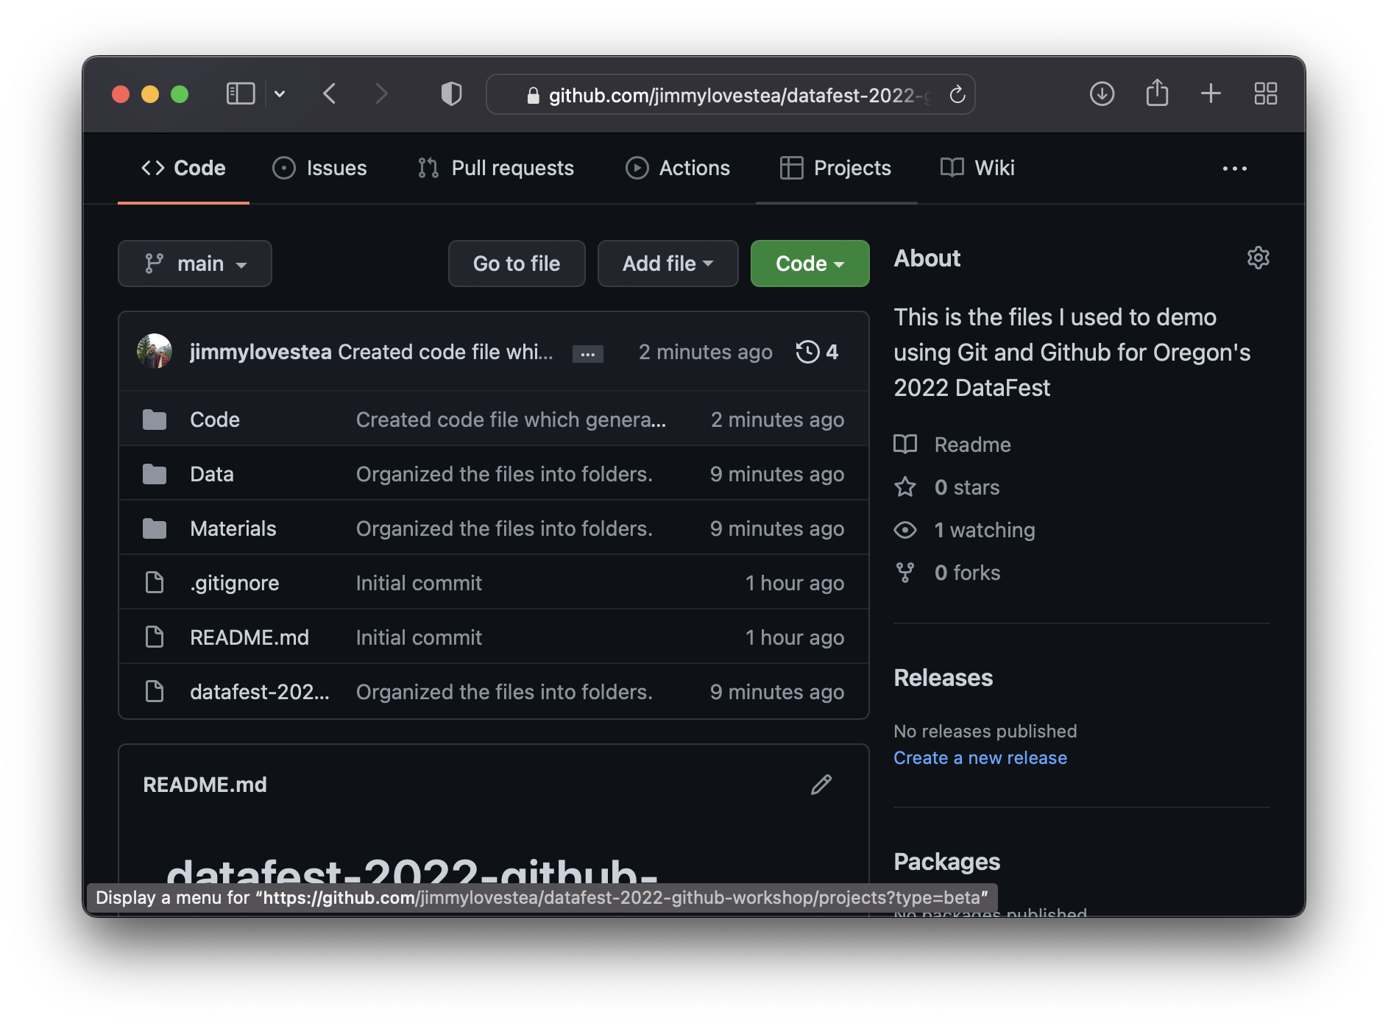
Task (2) : Add Some Code Files and Push
Create a new folder to hold your Code files.
Then create a code file which accomplishes some task.
Now that are new task is finished, let’s commit the changes again but this time, don’t close the window after hitting commit.
In the upper-right hand corner, notice that there’s a “Push” button (click it)
Clicking Push sends the changes we’ve committed back to Github.

Slide 35
Task (3) : Take Other’s Changes and Pull
If you have collaborators and are sharing a Github repo with them, it’s likely that they’ll add files that you want to access/use
For this workshop, I don’t have any collaborators, but let’s see how we can pull changes back to Rstudio.

Slide 36
Task (3) : Take Other’s Changes and Pull
Click on the README.md file. This file contains the content people will see below our code files when they visit our repo.

Slide 37
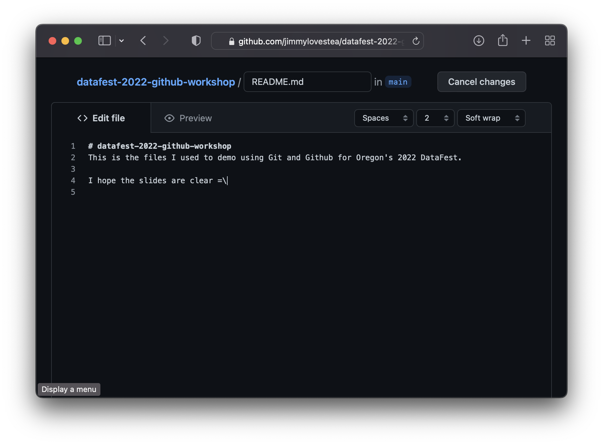
Task (3) : Take Other’s Changes and Pull
Click on the README.md file. This file contains the content people will see below our code files when they visit our repo.
Make some edits to the file

Slide 38
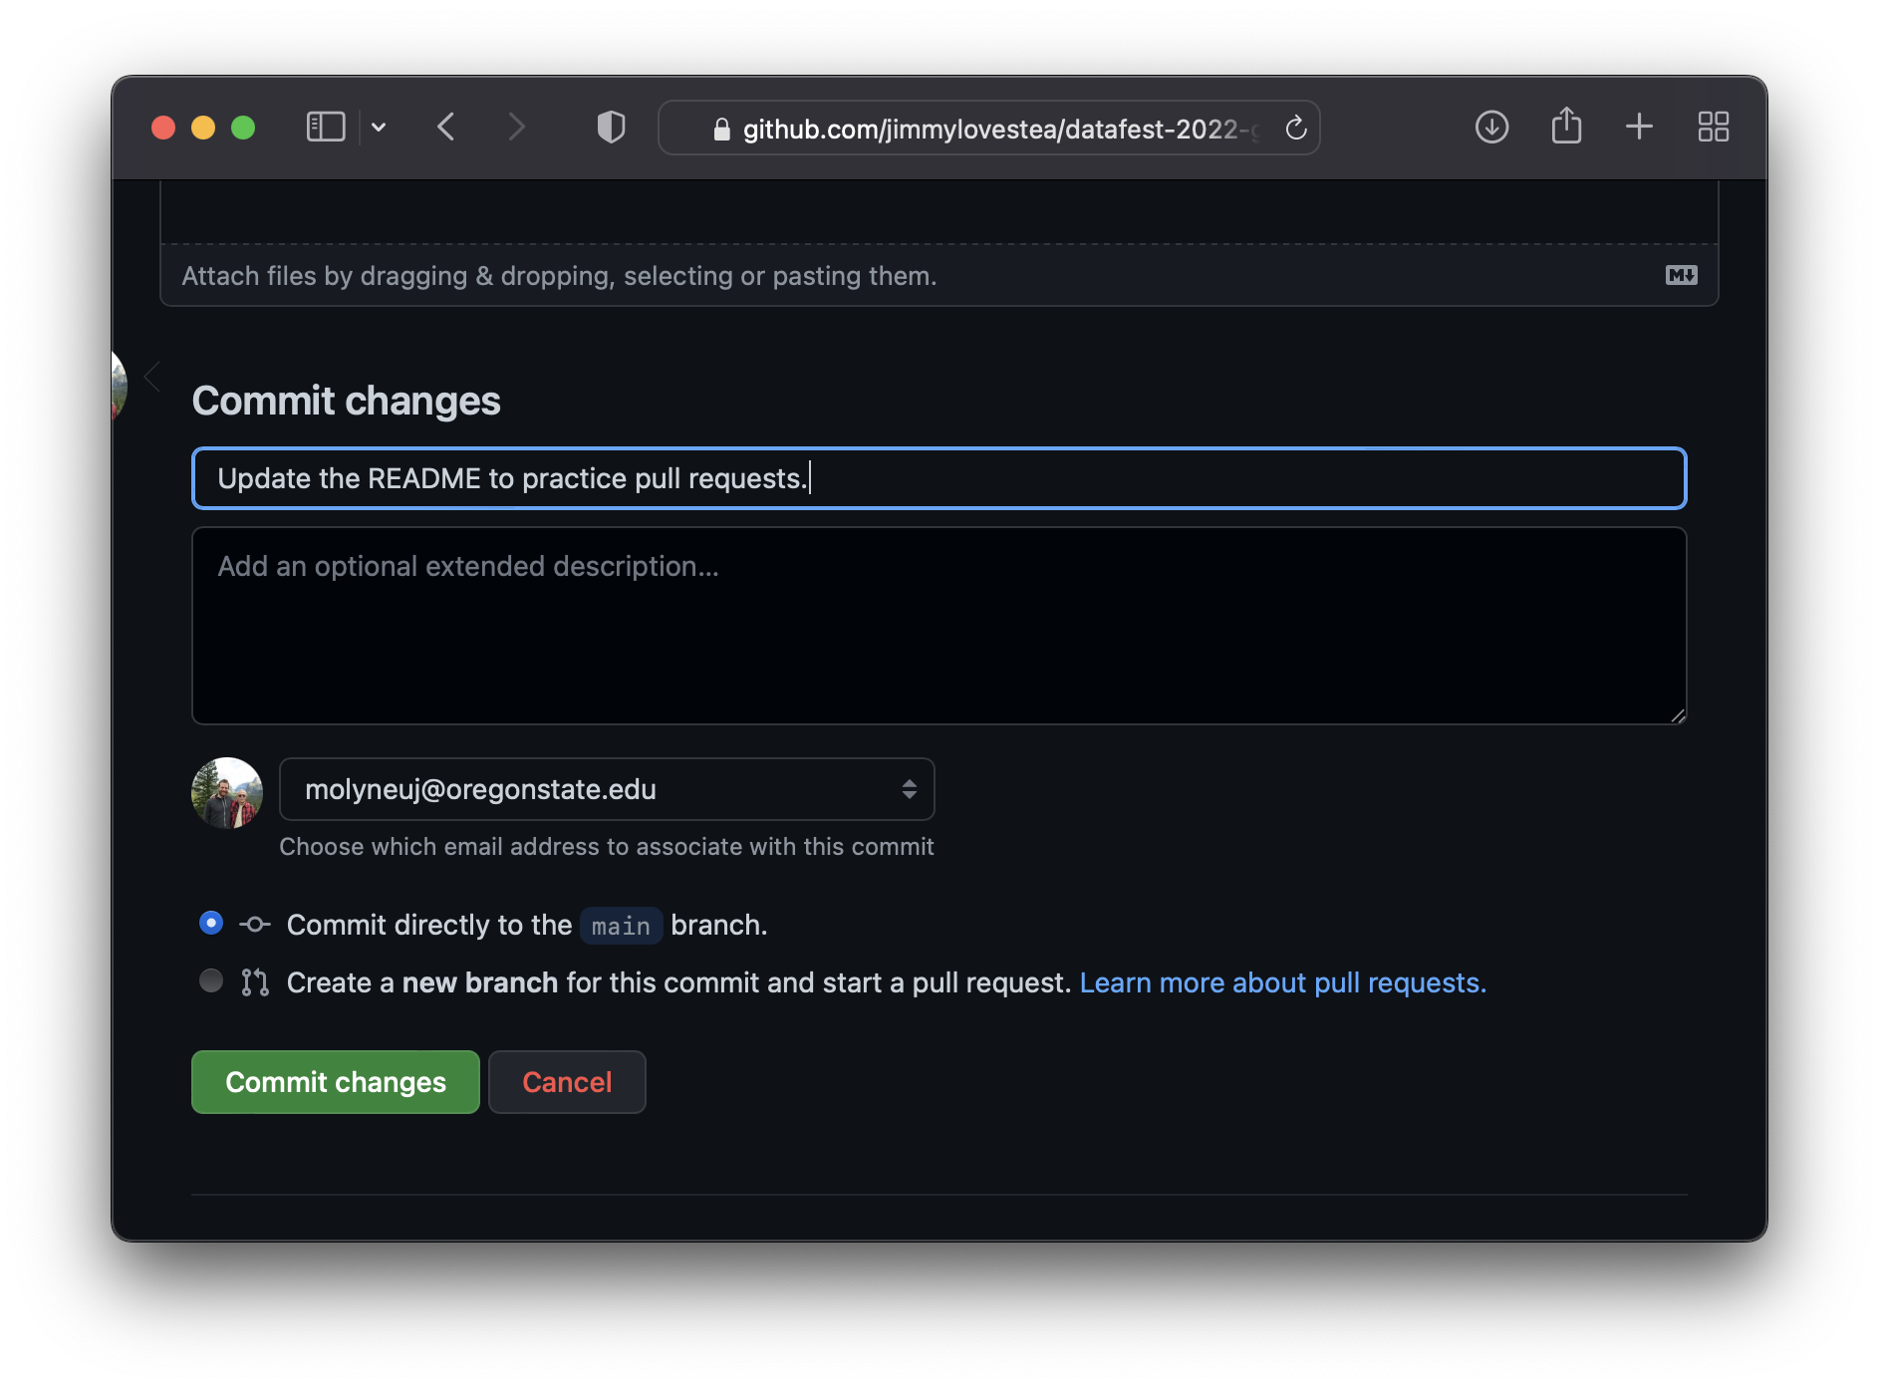
Task (3) : Take Other’s Changes and Pull
Click on the README.md file. This file contains the content people will see below our code files when they visit our repo…
Make some edits to the file
Then commit then changes

Slide 39
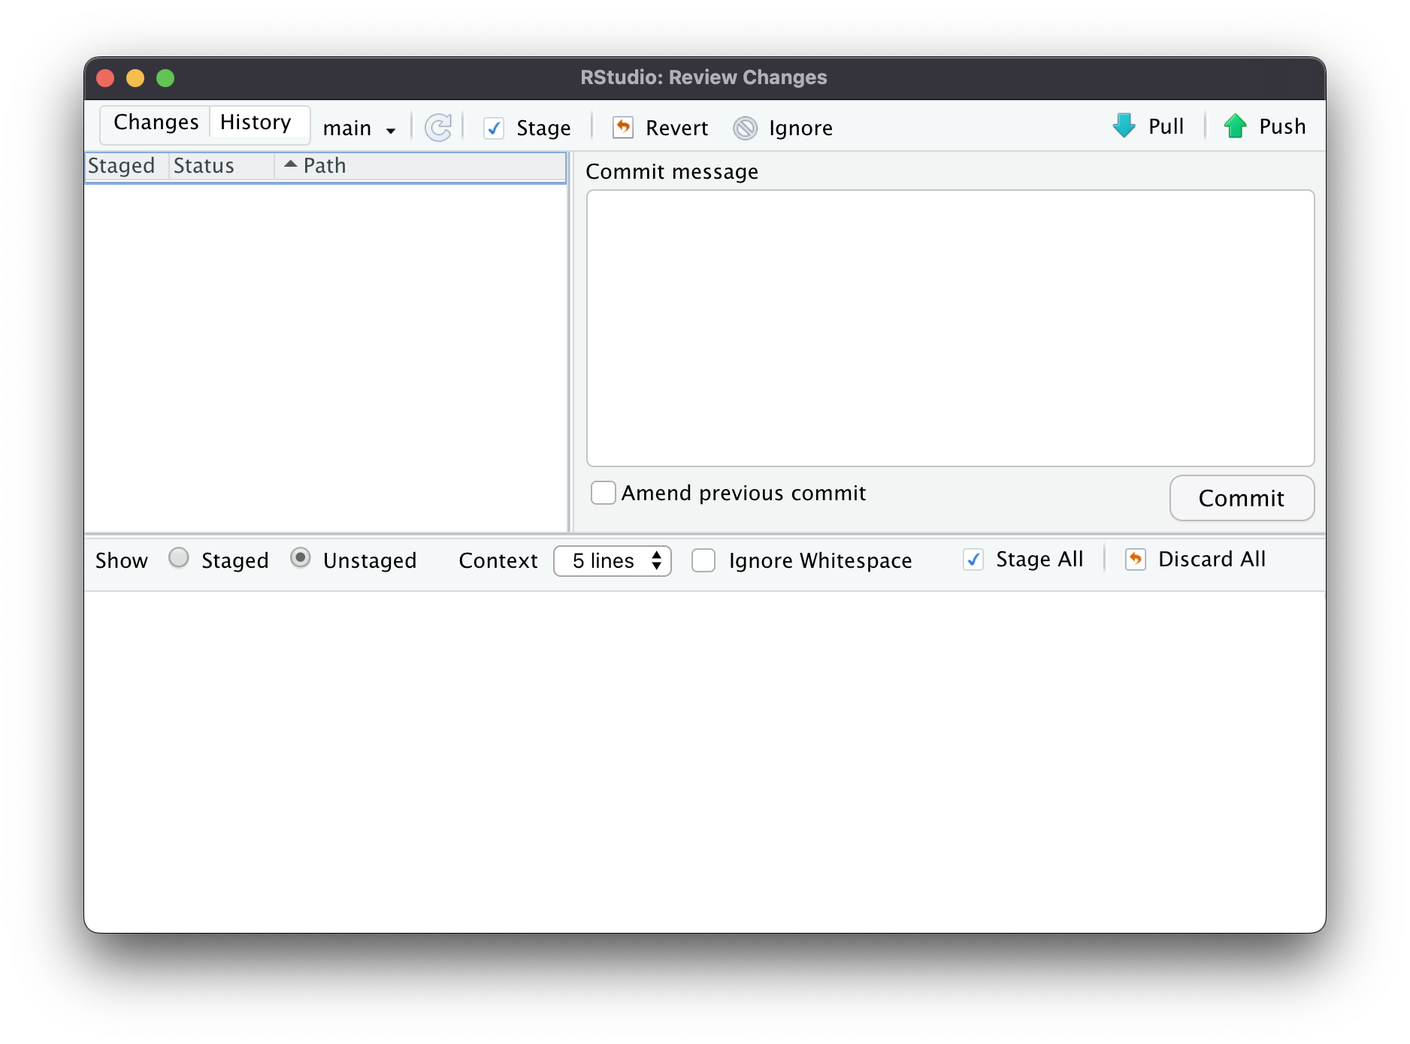
Task (3) : Take Other’s Changes and Pull
Click on the README.md file. This file contains the content people will see below our code files when they visit our repo…
Then commit then changes
Back in Rstudio, click the Commit button in the Git tab. Then click, “Pull”. This brings the repo files and copies them to your computer.

Slide 40
Chapter 4: What else?
Where do I go from here?

Slide 41
Other Git Topics
Setting up .gitignore files
Automatically tells Git files you don’t want to track.
Branches
Have separate versions of folders and files you can flip back-and-forth to.
Dealing with merge conflicts
What happens if multiple files don’t “mesh” together?
And lots more…

Slide 42
Other Github Topics
Using Forks to work on larger projects.
Keeping track of issues
Where can we document bugs and ideas for new features?
Creating/using SSH keys for secure file upload/download.
Using Github as a personal website
And lots more…!

Slide 43
A few tips…
Commit often
Work on a task, commit the changes.
When you’re “done”, push your changes back to Github.
Take “turns” working on files.
This can help avoid merge conflicts which are a hassle to deal with, especially when you’re just starting to use Git & Github.
If you break something and feel lost and abandoned …
Move the files you’ve been working on elsewhere.
Re-clone your repo.
Move the files back, then push.
Eventually, you can avoid this by learning more about rebasing and rolling back commits.

Slide 44
Next steps #1 : Get Organized
New Project Folder
Code Folder
00_load_data.R
01_clean_data.R
02_helpful_functions.R
…
Data Folder
Raw Data
my_data.csv
Production Data
my_data.Rda
Writing
my_article.Rmd
Readme.md

Slide 45

Next steps #2 : Build Your Portfolio
New Project Folder
Code Folder
00_load_data.R
01_clean_data.R
02_helpful_functions.R
…
Data Folder
Raw Data
my_data.csv
Production Data
my_data.Rda
Writing
my_article.Rmd
README.md

Slide 46
Next steps #3 : Practice =)

Slide 47
Git/Github Resources
R Packages – Chapter 18
https://r-pkgs.org/git.html
Happy Git and Github for the UseR
https://happygitwithr.com/index.html
Pro Git
https://git-scm.com/book/en/v2
-----
Github Help
https://docs.github.com/en
Stackoverflow
https://stackoverflow.com/questions/tagged/git

Slide 48
Thank you =)

